Slide 2
Aims
We will:
• unearth the underlying problems that trigger stress in the school
• assess the coping strategies already in place
• explore alternative wellbeing strategies
• investigate ‘unfreakability’ and what that looks like in a teacher
• discover the secrets of power breathing

Slide 3
W I F L E
What I Feel Like Expressing

Slide 4
Wellbeing strategies
What are our biggest stressor(s)/problem(s)?
How do we cope at the moment?
What healthy strategies do I use to support myself? (as a human being not a human doing!)
What healthy strategies do I use to support my teaching excellence?

Slide 5
The ‘unfreakable’ teacher
‘Perhaps the most indispensable tool for man in modern times is the ability to remain calm in the midst of rapid and unsettling changes. The person who will survive the present age is … the one who can keep his head, while all about are losing theirs. Unfreakability refers to man’s propensity… to see the true nature of what is happening around him and to respond appropriately. This requires a mind which is clear because it is calm.’
W Timothy Gallwey, The Inner Game of Tennis

Slide 6
Relax!
MIND Create personal headspace; mindfulness, meditation, creative visualisation …
BODY Release tension; ‘body scan’, exercise, dance, laugh …
HEART Do what you love; hobby, family/social time, fun!

Slide 7
Your power is in your breath
Emotional breath
Your breath is the gateway to feeling calm and centred
Focus on your breathing and you will return to the present moment

Slide 8
Breathing secrets
To relax if you are stressed – longer exhale
To energise if you are exhausted – longer inhale
To centre for poise – inhale for 7, hold for 7, exhale for 7

Slide 9
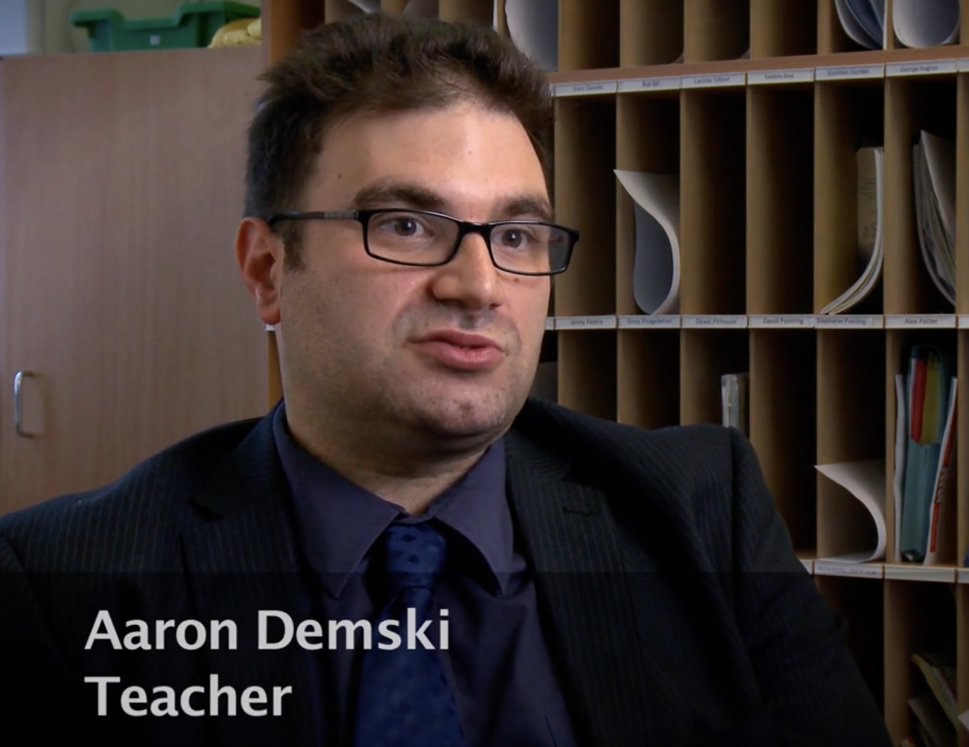
A teacher’s perspective

Slide 10
Meaningful change
 | Mental (mind) | Physical (body) | Emotional (heart)
What will I stop?
What will I start?
How will I implement this change?
Does it feel worthwhile or meaningful?
Wellbeing buddy

