Slide 2
Whole-staff unit
Prioritisation, managing your energy and time
Top three school stress reduction priorities
Top three school wellbeing initiative priorities

Slide 3
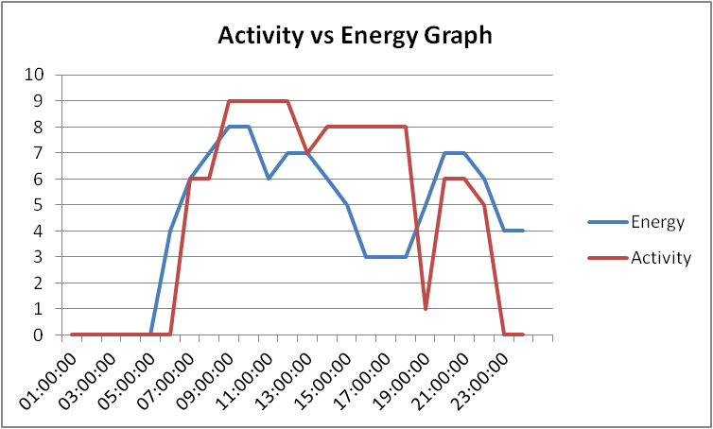
Understanding your energy
Plot your usual activity in one colour (0 = asleep, 10 = full output).
Plot your energy levels in another colour.
Highlight your stress danger times and energy strengths.
What can you do to improve personal effectiveness during the teaching day?

Slide 4
Supporting and improving your energy levels
Activity | Will help you feel more energised | You are able to commit to
Drink more
Sleep more
Eat well
Eat regularly
Avoid junk food
Stop drinking coffee/cola/energy drinks
Exercise – do some or do more
Rest
Stop rushing
Have a massage
Go to a relaxation class
Seek support from complimentary therapy: Acupuncture Reflexology Kinesiology Aromatherapy Physiotherapy etc
Learn to meditate
Take up a hobby
Socialise more
Set a sensible marking curfew
Have a holiday during holidays!
Leave work at school
Set work-life boundaries
Prioritise partner once a week (Have a date night!)

Slide 5
Managing your time
Where does the time go?
Five ways to avoid procrastinating!
Keep a time log over one week and assess where you spend most of your time.
URGENT NOT URGENT
IMPORTANT
1 | 2
3 | 4
NOT IMPORTANT

Slide 6
Work-life balance
‘Emotional stress and poor emotion management consistently rank as the primary reasons teachers become dissatisfied and leave teaching.’
Darling-Hammond, 2001; Montgomery & Rupp, 2005
Encourage a ‘live well’ ethos.
What measures can you implement to thread wellbeing throughout your teaching day?

Slide 7
Encouraging a low stress culture
What underlying structures can be improved to lower the stress culture of your school?

Slide 8
Sustaining a ‘flourishing’ school culture
What can you do to support a ‘flourishing’ culture in your school for each of the school groups?
SLT
Teachers
Teaching support staff
Operations support staff
Pupils
Flourishing : ‘to live within an optimal range of human functioning, one that connotes goodness, generativity, growth, and resilience.’ Wikipedia

Slide 9
Make it easy, keep it simple
Develop underlying structures that demonstrate ‘the school’ cares for you, because you're worth it!
KISS – Keep it simple and succeed!

Slide 10
Your wellbeing commitment
Eliminate blame culture.
Keep up the buddying system – ensure every new member of staff is allocated a wellbeing buddy on arrival.
Use the text codes to keep it simple and keep sharing the love!
Focus on health, happiness, support and encouragement.

Slide 11
Sustaining school wellbeing
Give your colleagues a PAT on the back regularly...
Praise
Affirm
Thank
Ask for Help!
Teacher Support Network
Evaluation form
Have fun! www.youtube.com/watch?v=k_881KKfHCY

