Slide 1
Managing the Mental Health of ALL during challenging times

Slide 2
Objectives of this Webinar
We look at ways to improve our OWN mental health and resilience to cope with exceptionally challenging times both at work and at home
We look at the best ways to stay emotionally connected with your teams now they are working remotely and how to keep them engaged
We give you hints and tips to help you have a productive and enjoyable day when working from home
We give you specific advice as to how to protect your mental health during the coronavirus

Slide 3
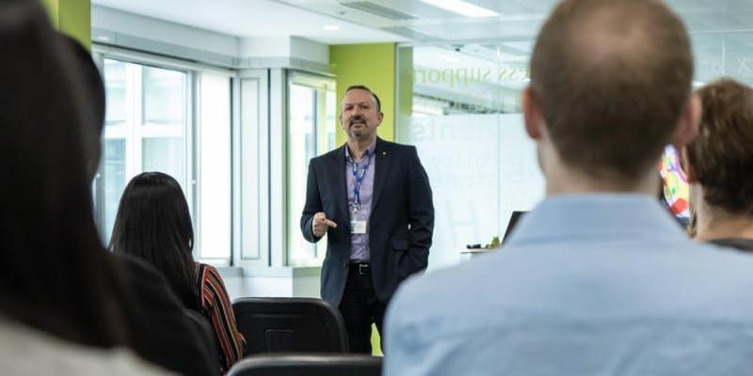
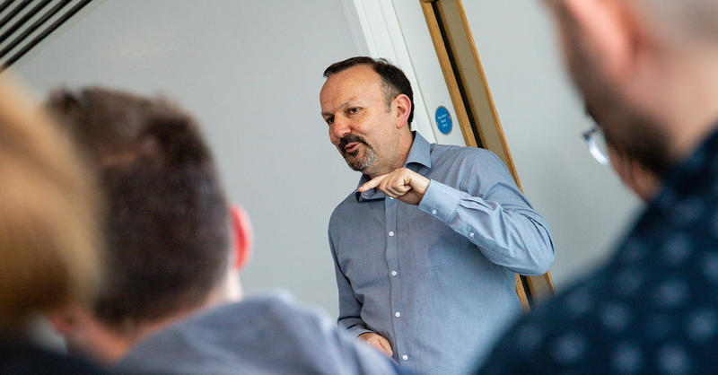
Introducing
David Beeney
FOUNDER of BREAKING THE SILENCE LTD.

Slide 4
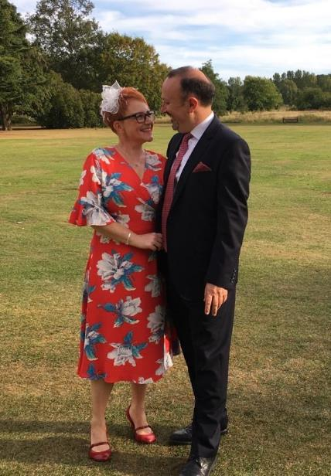
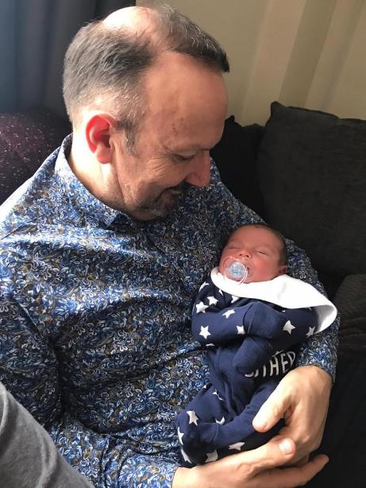
Engaged to Lisa
Grown up kids – Joel, Jodie and (step-daughter) Casey
Recently became a grandad to Noah
Live in Hemel Hempstead

Slide 5
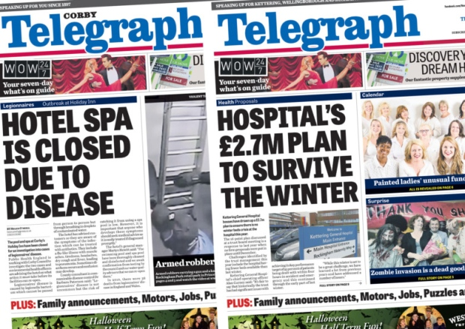

Slide 6
.....but on 16th May 2016, my whole life changed forever!
Notes:
The worst day of my life
Talk through the day – what happened/thoughts/feelings/fears/complete panic
Talk through what happened the next day

Slide 7
I came out after 30 years about my poor mental health
Nobody in my life had any idea
I spent 36 years avoiding doing what I am doing right now!
How do I now avoid panic attacks?
It’s okay not to be okay
You inspire when you share vulnerability
I have discovered the true value of self compassion

Slide 8
1 in 4
Notes:
Statistics on mental health
What does this slide tell us? 1 in 4 EVERY year will suffer
How many of us have mental health?
Another scary stat.
Suicide – is the biggest killer of men
Most data is considered ‘light’ because men do not present the real issues to GP’s or do not go at all.
However, still 1 in 10 of us a year go to the doctor with anxiety or depression

Slide 9
1 in 1
Notes:
Statistics on mental health
What does this slide tell us? 1 in 4 EVERY year will suffer
How many of us have mental health?
Another scary stat.
Suicide – is the biggest killer of men
Most data is considered ‘light’ because men do not present the real issues to GP’s or do not go at all.
However, still 1 in 10 of us a year go to the doctor with anxiety or depression

Slide 10
How many of you have experienced any of these?
Lack of Energy
Stress
Struggling to Concentrate
Problems Sleeping
Mental Fatigue

Slide 11
What does a training programme look like to become mentally fitter?
How do we build our own resilience?

Slide 12
Regulate Sleep
Physical Exercise
‘Me’ Time
Play Time
Fun & Laughter
Give yourself treats
Give yourself things to look forward to
Reduce contact with certain people!
Healthy diet
Be honest with yourself

Slide 13
How do you spot signs that a family member, friend or work colleague may be suffering with poor mental health?
How do you then start a conversation about their wellbeing without you or them feeling too awkward?

Slide 14
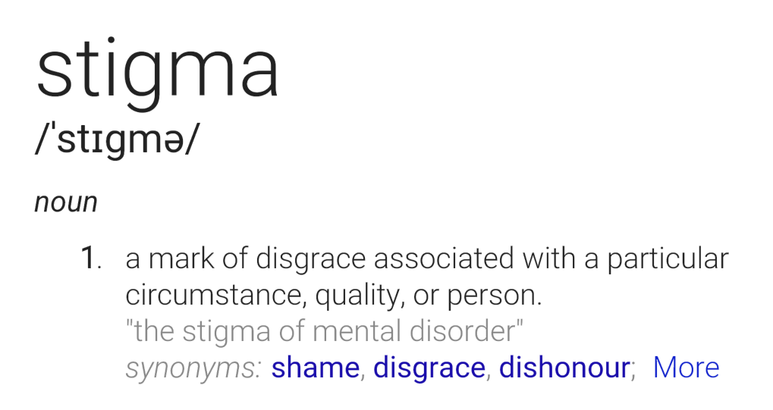

Slide 15
SILENCE

Slide 16
Keeping your Remote Workers Engaged and Energised

Slide 17
Four things have to happen…
1
Your employees must feel that you are giving them priority over business performance
2
Your line managers must understand the value of kindness to both the employees and the business
3
Senior people should share vulnerability to inspire their workforce – it is not weakness
4
Everybody needs to be kind to themselves as this will build resilience during tough times

Slide 18
Key Tips for Managers:
1
Ask employees how they are and listen non-judgementally before asking about work
2
Ensure the tone of all forms of communication are empathic and display trust
3
Think about the language you use when asking about wellbeing – e.g. ask them for a score out of ten
4
Try and speak to your employees every day but not all the conversations have to be about work

Slide 19
Suggested Process for Managers when having a Mental Health Conversation
1
2
3
Thank them for sharing and listen without judging
Show support and sensitively check whether work is a factor
Advise talking to a Health Professional
(EAP/Doctor/Counsellor)
4
5
Take private notes for yourself of the conversation and disclose as appropriate
Thank them again and agree when you’ll next check in with each other

Slide 20
Hints and Tips to help those working at home
1. Leave the house, even if standing on your doorstep or the garden
2. Move around the house, each time shifting to a new zone can re-energise you
3. Put some boundaries around your work
4. Stay focused and switch off distractions
5. Have some social interaction
6. Know what YOU need to have a good day

Slide 21
Suggestions to protect your mental health during the Coronavirus
1. Limit the time you spend watching things which aren't making you feel better
2. Perhaps decide on a specific time to check in with the news
3. Stay informed and avoid fake news by sticking to trusted sources of information
4. Mute key words which might be triggering you on Twitter and unfollow or mute accounts
5. Mute WhatsApp groups and hide Facebook posts and feeds if you find them too overwhelming
6. Stay connected with people
7. Avoid burnout with potentially months of the coronavirus pandemic ahead
– it is important to have down time
8. Exercise, eat well and stay hydrated

Slide 22
EAP (Employee Assistance Programme)
Who can I talk to in confidence?
Your Line Manager
Member of HR Team
Mental Health First Aider
Colleague
Your GP
Family Member
Friend
Mental Health Charity
Notes:
I am happy to talk to anybody but I will simply point you to the right people.
I will advise on the different modalities of therapy…..a real passion of mine.

Slide 23
A little more conversation

Slide 24
Thank you for listening
David Beeney
07572 211610
davidbeeney@breakingthesilence.co.uk
breakingthesilence.co.uk

