Slide 1
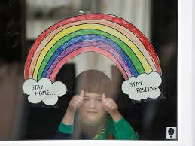
Covid-19 and young people’s wellbeing: school support
Dr Emma Silver
Consultant Clinical Psychologist

Slide 2
Overview
What whole school wellbeing looks like when we’re physically in school
Adapting whole school wellbeing in the context of Covid-19 and remote learning
Levels of support for pupils, parents (and staff - covered in next presentation)
Specific issues with mental health and young people in the time of Covid-19

Slide 3
National Context: Schools & Mental Health Green Paper 2018
Mental Health Lead in every school by 2025
Oversee the help school gives to pupils with Mental Health problems
Help staff to spot signs of difficulties
Offer advice to staff about Mental Health
Help with referral of pupils to specialist services
Plan to ask people’s advice on how pupils learn about Mental Health in school
Mental Health Support Teams in school:
Offering interventions for mild to moderate difficulties
Work with mental health lead to provide links with specialist services
whole school approach to wellbeing
Notes:
Focus of Green Paper is on mental health – my role does include that – and some staff will have already experienced some of my input around pupils and families struggling with mental health difficulties.
What I have noticed in my first few weeks is very committed staff working with young people and families who are presenting with mental health issues. I have seen how time consuming and emotionally draining and at times de-skilling that has been for staff. I’ve also seen thoughtful, caring responses from teachers, working together with a team of counsellors and welfare officers to support pupils. Its shown the dilemmas of what and how to communicate information with the young person, parents and staff and external agencies while maintaining respect for confidentiality and managing risk/safeguarding. There will always be these dilemmas, and I hope my role can support the staff and young people involved.
But a main part of my role is wellbeing for the whole school – to build on what you are doing well for the pupils, and also for yourselves.
You’ve all come back today off a break – hopefully it was restful, although I know xmas and families can also be fraught. Without considering our own wellbeing its going to be really hard to be able to do that for the pupils in the class. So, as I talk about what young people need to thrive in school and what you as teachers are doing to support that, I’d like you also to think about what it is that you as a teacher or support staff also needs and provide for each other.
I will start with some data about mental health in young people, what’s happening in adolescent development and then to consider what teachers are doing and can do more of to support young people in school. These concepts may seem fairly basic, but I think they are important and you are all able to implement them in a range of ways

Slide 4
Whole School Wellbeing - Pupils
Additional support
for the most vulnerable
Supportive systems for those at risk
Consistent positive practices and environment for all pupils

Slide 5
Universal support
All school staff are involved in monitoring pupil
wellbeing, teaching social and emotional skills, and
pastoral care… how does this work in remote
schooling?
All pupils are in families – school support has
always extended to parents, but now this is an
essential part of the pastoral care.
What is affecting families is affecting pupils even
more now as they spend all their time together.

Slide 6
Providing a balanced learning day
Balance between some video contact if possible and setting work to do – so not too much time on screens
Age appropriate – who is there to support the child access the work?
PSHE, Exercise, self-care (daily dose), extra-curricular opt-in, giving (charity)
Encourage contact with teachers and peers – and manage expectations of availability
Clarify if doing assessments and how those will happen, and what they will mean
End the school day

Slide 7
Manage expectations
Managing expectations of staff, pupils and parents is important.
They need to know that they probably won’t get through as much as they would normally, and that they aren’t expected to. The pace is different.
Parents need to know that their children’s mental health and general wellbeing is more important than their academic achievement – particularly at this time. So the day needs to be balanced.

Slide 8
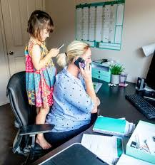
Supporting Parents
Parents are being asked to do the near
impossible… looking after children of different ages, support and enable their home schooling, while holding down their own jobs, managing the home, containing the emotions in the family, perhaps caring for elderly parents.
Supporting parents is essential – they may be struggling financially, practically and emotionally
Many of your staff will be parents – you can see how hard it is for them to juggle teaching
and childcare and need to support them

Slide 9
Parents need guidelines about remote schooling
Clear advice about setting up a
structure to the day at home – top tips - scaffolding
Support with access to being online and online safety information
What’s expected regarding screentime?
Manage concerns about rate/pace
of learning …and value for fees
Put wellbeing first – ensure that
they have breaks and fresh air
(where possible) and are able to connect
with peers outside of school time

Slide 10
Information for Parents – where it is accessible, clear, age appropriate
Guidance for parents and carers on supporting children and young people’s mental health and wellbeing during the coronavirus (COVID-19) outbreak
https://www.gov.uk/government/publications/covid-19-guidance-on-supporting-children-and-young-peoples-mental-health-and-wellbeing/
Primary school:
A book explaining the coronavirus to children, illustrated by Gruffalo illustrator Axel Scheffler. The book answers key questions in simple language appropriate for 5 to 9 year olds.
https://nosycrow.com/blog/released-today-free-information-book-explaining-coronavirus-children-illustrated-gruffalo-illustrator-axel-scheffler/
Dave the dog is worried about coronavirus - A nurse Dotty book for children about coronavirus that aims to give information without fear.
https://nursedottybooks.files.wordpress.com/2020/03/dave-the-dog-coronavirus-1-1.pdf
Some ideas about managing worries:
https://www.childline.org.uk/toolbox/calm-zone
Helpful advice for parents (and their children), at this difficult time, on the following site:
https://www.annafreud.org/coronavirus
.
Offer support to parents who are struggling –
Eg. School counsellor having sessions with parents

Slide 11
Monitoring pupil wellbeing
Usually teachers are able to make use of their excellent observation skills to notice changes in pupils’ behaviour, learning, relationships etc to wonder if something is not going ok for them…
But remotely we no longer have that data to help monitor pupil wellbeing
Need to find other ways…

Slide 12
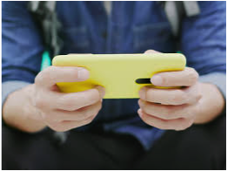
Monitoring Pupil Wellbeing Remotely
Form tutors checking in with group of pupils remotely at form times
Monitoring who is accessing remote schooling – noticing patterns and alerting HoY to those who are not engaging at all
Individual check-ins with pupils – zoom/phone. Need to involve parents depending on age
Survey of pupils well being

Slide 13
Example Pupil Wellbeing Monitoring
Example questions (adapt for age):
- How are you doing in yourself?
1 2 3 4 5
- How are things in your family?
- How is your remote learning going?
- How are you doing overall?
Would you like to talk to anyone in school about how things are going for you?

Slide 14
Checking in with pupils…
How are you? How are your family?
How are things going for you at home?
How have you been finding the remote learning? What are you finding that is working well ? And what is not working for you?
Have you had any difficulty accessing or completing the work? Are there any subjects causing you more concern? (if pupils have subject concerns, they should be told to email their teacher, with IT concerns they should be told to email IT Support). May need to follow up with questions about who is supporting them to access the lessons (check if they are being supported by a parent)
How are you managing to structure your day to get breaks? Check they are leaving their desk, moving around, getting some fresh air etc.
What have you been enjoying (in and outside of school things)?
Are you connecting with friends online?
What else have you been up to that isn’t school stuff?
Is there anything that you are worried about? (Tutors to remind the pupils about the Get Help Here/Counselling provision)
How would you know if things were getting difficult for you (what would you notice)? Who would you talk to? How would you let me know if you needed further support?
End the check in by asking something like - is there anything else that you think would be important to talk about that would be helpful for you in how things are going for you?

Slide 15
Provide information for pupils where they can easily access it
Looking after yourself while social distancing and self isolating: https://youngminds.org.uk/find-help/looking-after-yourself/coronavirus-and-mental-health/#i-am-struggling-with-self-isolation-and-social-distancing-
https://youngminds.org.uk/blog/looking-after-your-mental-health-while-self-isolating/
Coronavirus and managing your mental health and wellbeing: https://youngminds.org.uk/find-help/looking-after-yourself/coronavirus-and-mental-health/
A resource pack for teenagers to help manage feelings about coronavirus: https://36bcba96-c643-4a57-97c9-a5d0a468fe3a.filesusr.com/ugd/e3ca78_d6c1247bd7e5405b9b3109075f38bd47.pdf

Slide 16
Whole School Wellbeing - Pupils
Additional support
for the most vulnerable
Supportive systems for those at risk
Consistent positive practices and environment for all pupils

Slide 17
Identifying vulnerable pupils
Previous concerns about pupils due to
mental health,
family issues,
physical health
Pupils who were not engaging with school before lockdown
Pupils with safeguarding concerns
Pupils in the middle of parental separation
Pupils may be added to your ‘at risk’ or ‘concern’ list because of lockdown or impact of covid-19
Bereavement

Slide 18
Strategy for monitoring & support for vulnerable pupils
1:1 weekly check ins (HoY, tutor, pastoral lead). How to do these safely – phone/video.
Check in with parents if appropriate
If not engaging with school at all – follow up
If outside services (CAMHS, Social Care, private clinicians) are involved school can maintain liaison (with consent).
School counselling remotely for some pupils
Refer to outside services if needed – local council covid support, MASH, CAMHS etc. But be aware of what these services can and cannot provide at this time
Other pupils may report concerns about friends – take these seriously and support the friends too
Manage boundaries safely

Slide 19
Provision for Pupils attending school
Children of key workers
Vulnerable pupils – with social care involvement where it is deemed better for them to be in school than at home
Ensure enough staff on site, enough first aid trained, with support from a senior manager

Slide 20
Developmental stage and impact of lockdown
Young children missing school and friends
Adolescence – time of individuation, separation, more independence….now stuck at home with parents knowing their every move!
Importance of peer relationships in
Not able to engage in activities that connect
young people and give sense of enjoyment & achievement
Young Adults – home from university when they were gaining more independence
Young people taking on caring roles for parents
Increased family conflict
Managing relationships online and social media

Slide 21
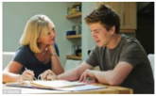
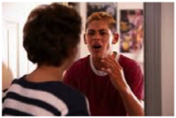
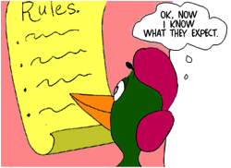
Family Relationships in Lockdown
Opportunities to spend time together…
But…
Heightened emotions, parental
stress and MH – harder to consider the minds of
others
Adapting to change –
does everyone know what’s
expected of them in the home?

Slide 22
Psychological Impact of Covid
Not knowing when:
Lockdown will end… and what that will look like
when school will re-start
about outcomes of non-exams
about parents’ work
about university next year…
Uncertainty & lack of control is associated
psychological problems
Affecting those already diagnosed with mental
health problems and those with no previous
difficulties

Slide 23
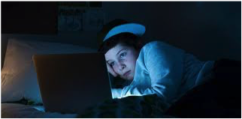
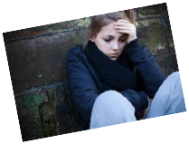
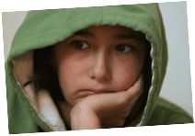
Psychological Impact
Seeing a deterioration in people already suffering with depression, anxiety, OCD, PTSD, addictions, sleep problems
Psychological distress and symptoms that they have never experienced previously – need to reassure that it’s not unusual to experience distress in such a situation, and direct them to access appropriate support

Slide 24
School Bereavement Response
Clear strategy prepared for range of scenarios – death of pupil, parent, staff member.
Support for bereaved staff
Information prepared on support systems
Information on bereavement and support services for families and young people

Slide 25
Bereavement Resources for Schools
1. This has good information about how to support grieving children in education with guidelines for how to understand the responses of and talk to children of different ages/developmental stages: https://www.winstonswish.org/wp-content/uploads/2019/06/Guide-to-supporting-grieving-children-in-education.pdf
2. This is a whole school strategy in responding to a death – give guidance for schools: https://www.winstonswish.org/wp-content/uploads/2019/06/Strategy-for-schools.pdf
3. This is useful in the current context of Covid-19 as it gives ideas about managing arrangements
remotely. It also offers direct support to young people, parents and schools: https://www.winstonswish.org/coronavirus/
4. These are other support services with good advice and support for both adults and children. They have phone support and online support:
https://www.cruse.org.uk/get-help/coronavirus-dealing-bereavement-and-grief
https://www.griefencounter.org.uk/child-bereavement-support/advice-and-information/
https://youngminds.org.uk/find-help/for-parents/parents-guide-to-support-a-z/parents-guide-to-support-grief-and-loss/#how-can-i-help-my-child?
This one is good information for young people about grief: https://youngminds.org.uk/find-help/feelings-and-symptoms/grief-and-loss/

Slide 26
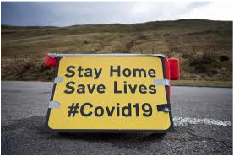
The psychological well being of our young people is everyone’s business…

