Slide 1
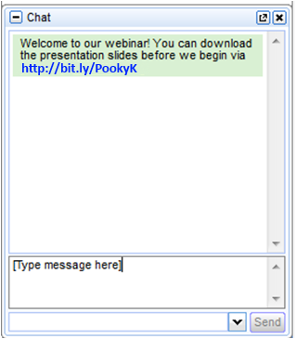
Understanding and Supporting Self-Harm
Dr Pooky Knightsmith

Slide 2
I will help you understand:
What self-harm is and the types we might encounter
Why people turn to self-harm
Triggers and warning signs
How to respond and support

Slide 3
What do we mean by self-harm?

Slide 4
Cutting, burning, embedding
Harm to oneself in order to cope
Overdosing, consuming poison
Scratching, banging
Punching, hitting, biting
Eating disorders, drugs, alcohol

Slide 5
Self-harm can be direct or indirect
e.g. cutting vs risk taking
Self-harm can be transient or longer term
Self-harm is usually conducted at times of anger, distress, fear or worry…
…and is a way of coping with these feelings

Slide 6
Negative Emotions
Self Harm Cycle
Low
Inability to Cope
High
Self-harm

Slide 7
Why do people self-harm?

Slide 8
Punishment
Control
Feel cared for
Why?
Appear ugly
Fit in
Manage feelings
No better ways
Feel real

Slide 9
Triggers
Relationship difficulties (family or friends)
Trauma
Exposure via friends, family, media
Difficult times of year e.g. anniversaries
Increased academic pressure
Times of change
Bullying

Slide 10
What signs might alert us?

Slide 11
Personality
Low or anxious
Feels hopeless
Secretive / snappy

Slide 12
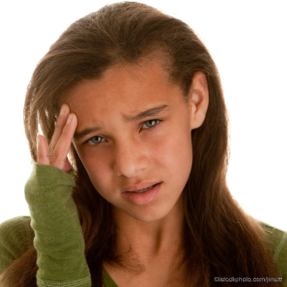
Physical
Injuries / scars
Clothing
Weight change

Slide 13
Behaviour
Withdrawn / isolated
Avoids changing rooms
Eating / sleeping

Slide 14
How can we help?

Slide 15
Address self-harm in relevant policies
Whole School Ideas
Teach self-harm safely in PSHE
Teach resilience and stress management
Signpost support
Give staff access to training

Slide 16
Supporting Individuals

Slide 17
x
Negative Emotions
Self Harm Cycle
Low
Inability to Cope
High
Self-harm

Slide 18
How we can help
Listen
Make time

Slide 19
How can I help?
How can I help?
OMG!
What to say
What NOT to Say
Well done for trying
Well done for trying
Why?
I care
I care
Stop…

Slide 20
What if a student won’t talk?
Are you the best person?
Start with small stuff
Don’t get angry
Go for a walk
Keep offering support
Signpost support

Slide 21
How we can help
Listen
Make time
Offer practical ideas
Don’t dismiss

Slide 22
Self-Harm Alternatives

Slide 23
Write or draw about feelings
Talk to a person or helpline
Go to a quiet place and scream / scream silently
Hit a pillow / soft object
Listen to music
Look after an animal or sibling
Draw red lines on the skin
Clench ice cubes
Snap elastic band on wrist

Slide 24
When I feel the urge to self-harm I will…
1. Start with the least invasive
2. The sort of thing you could do in maths
3. Work your way up..
4. Always include a 24 hour helpline
5. The final strategy is your ‘nuclear option’

Slide 25
How we can help
Listen
Make time
Offer practical ideas
Don’t dismiss
Involve friends

Slide 26
Peer Support
“The most helpful thing for me during my recovery was having a friend who cared. She was brilliant. She listened when I needed to talk and she answered all sorts of difficult questions from my friends. She made me feel safer.”

Slide 27
Safe Peer Support
Appropriate support should be put in place (someone to talk to)
Consult parents
Agree boundaries
Discuss role of staff / counsellor etc vs friends with both pupils
Ensure friend does not keep secrets. Explore idea of a ‘good friend’
Can always say no

Slide 28
How we can help
Listen
Remember the ‘real’ child
Make time
Offer practical ideas
Involve friends
Don’t dismiss

Slide 29
Cutter
Seb – great musician. Really funny. Very untidy.

Slide 30
“I think I’m better able to cope with life’s ups and downs than many of my friends now because I’ve had to think carefully about my response to difficult times.”

Slide 31
Hear more from Pooky Knightsmith at our
Benefits of attending
Take away a clear understanding of CAMHS processes
Identify and support your pupils who self-harm
Support pupils to successfully develop emotional resilience
Other speakers presenting on the day include:
Dr Nick Barnes, Young People’s Psychiatrist, Haringey Adolescent Outreach Team, NHS
Roger Catchpole, Training & Development Manager, Young Minds
Peter Connor, Deputy Headteacher, Framwellgate School
Find out more at: www.oeconferences.com/mentalhealth14

Slide 32
Webinar
Questions & Answers
--------------------------------------------------

