Slide 1
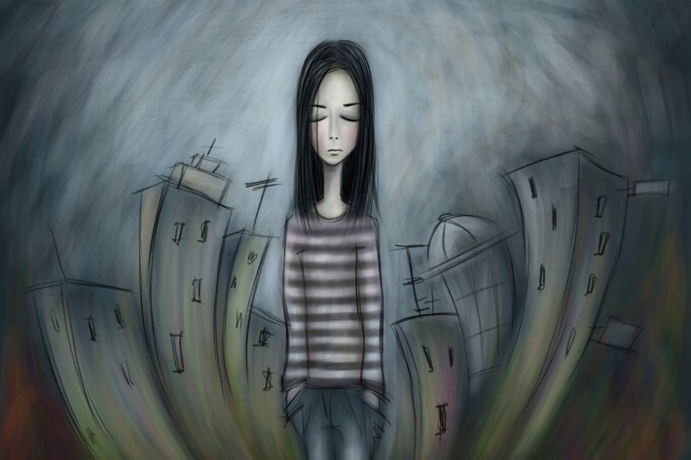
SELF-HARM ALTERNATIVES Over 130 Ideas for use during
self-harm recovery
Write down what made you feel angry and scribble it out until the paper is worn through
Reread your favourite childhood book
Put your books in height, alphabetical or colour order
Have a cold shower
Dr Pooky Knightsmith

Slide 2
At the moment when a young person is overcome by an urge or need to self-harm, it can be very helpful for them to have a range of different strategies they can tap into to try and cope with the way they are feeling right now without actually inflicting harm on themselves. This presentation contains in excess of 100 ideas which a young person could use as an alternative to self-harm.
These ideas were all suggested by former self-harmers.
These ideas are also presented in a separate hand-out that you can share it with a young person you’re working with. Different things work for different people at different times; there are a wide range of ideas here to try. It’s always worth having follow up conversations with the young person you’re working with to find out what’s worked and what hasn’t so they can refine their list and determine the best strategies to employ at the moment they’re overcome with the need to harm.
Good Luck!
Dr Pooky Knightsmith
Child and Adolescent Mental Health Specialist

Slide 3
HOME
Click on a link to visit the relevant page. Return here by clicking
Ideas that simulate self-harm
Ideas for when you need to vent your feelings
Ideas for when you feel alone or down
Ideas for when you need a distraction
Delaying tactics to give you a short time to think
Ideas to help you feel more in control
Ideas that remind you that you have a future
Ideas for when you’re confused
Ideas that nurture rather than harm
Ideas that remind you that you’re real
Ideas that won’t be noticed in busy situations
Notes:
In presentation mode, these titles all act as hyperlinks to the relevant slide

Slide 4
Ideas that simulate self-harm These are ideas that give some of the visual or physical sensation of self-harm without actually causing harm to the body.
Write on your skin
Finger paint with red paint
Clench ice cubes in your hands
On a photo or drawing of yourself, mark in red where you want to hurt yourself
Plunge your face into a sink full of freezing cold water for a few seconds
Paint your skin with red nail varnish or paint and pick it off
Ping an elastic band or hair band on your wrist (but not too hard)
Draw red lines on your skin where you want to harm
HOME

Slide 5
Ideas for when you need to vent your feelings Sometimes our feelings become too much for us to bear and the only way we can think of managing them is to hurt ourselves. Here are some alternatives that will help you vent anger, frustration or other extreme feelings.
Go somewhere quiet and scream
Punch a punch bag
Make a ball out of play dough and smash it
Hurl lumps of ice at the ground and watch them smash
Hammer nails into wood
Play squash
Tear up a magazine
Write down what made you feel angry and scribble it out until the paper is worn through
Dance like nobody is watching
HOME

Slide 6
MORE Ideas for when you need to vent Sometimes our feelings become too much for us to bear and the only way we can think of managing them is to hurt ourselves. Here are some alternatives that will help you vent anger, frustration or other extreme feelings.
Play music loudly
Bang drums or other percussion instruments
Run up hill
Write a letter to the person who has made you angry, venting your frustration (but don’t send it)
Cry
Cut up an old piece of material
Tear up cardboard
Have a pillow fight with a wall
Stamp your feet
Snap sticks in half
Sing VERY loudly
HOME

Slide 7
Ideas for when you feel alone or down These are ideas which will help when your mood is low. When you feel alone or deeply sad and you don’t know why.
Look at photographs of your friends and family
Think of your favourite day ever
Tell someone about your favourite day ever
Talk to someone you trust
Call a helpline or use an online forum
Listen to soothing music
Take a walk in the garden, notice each tree and flower and try to learn their names
Walk your dog
Go to the park and swing, listen to the laugher of children and let it infect you
Reread your favourite childhood book
Watch silly videos of cats on YouTube
Listen to a ‘feel good’ playlist of songs to lift your mood
HOME

Slide 8
Ideas for when you need a distraction sometimes the need to self-harm is less intense but it doesn’t go away that fast and you need something to take your mind off it for a little longer. these ideas might help. if you regularly self-harm at the same time each day, you might also find that these are good activities to do at that time, to see if you can avoid your regular self-harm session.
Watch something light-hearted on TV
Go for a walk
Call your best friend for a chat
Have a shower
Do a jigsaw
Find something beginning with every letter of the alphabet
Write a letter or an email
Read a book
Sleep
Learn the words to a new song
Practice a musical instrument
Curl up on a bean bag and watch the world go by
Play a computer game
Juggle
HOME

Slide 9
More Ideas for when you need a distraction Sometimes the need to self-harm is less intense but it doesn’t go away that fast and you need something to take your mind off it for a little longer. These ideas might help. If you regularly self-harm at the same time each day, you might also find that these are good activities to do at that time, to see if you can avoid your regular self-harm session.
Practice a new skill (e.g. speaking a language, juggling)
Bake
Sew or knit
Build a card house or line of cards then knock it down
Look for pictures in the clouds
Do some cleaning
Work in the garden, dead-head some flowers or do some weeding
Fly a kite
Watch out for birds and try to identify the different types
Skim stones – how many bounces can you do?
Dig for worms
Write a blog post
HOME

Slide 10
Delaying tactics to give you time to think When you’re trying hard to give up self-harming, sometimes you know that if you can just give yourself a little time to think then you’ll be able to reason with yourself. These ideas will buy you a minute or two to try and calm your anxiety and remind yourself of safer coping mechanisms (you might do one of these before going on to try one of the ideas in another category).
Set a timer on your phone for 60 seconds and watch it tick down before you do anything
Recite the alphabet forwards and then backwards
Practise your times tables
Take the item you intend to harm with and wrap it up in towels, blankets or newspaper
Count to 100
Sing ‘Twinkle, Twinkle, Little Star’
Run up and down stairs three times
HOME

Slide 11
Ideas to help you feel more in control If everything feels out of control and your urge to self-harm is because you feel like you need control something, try one of these ideas instead:
Put your books in height, alphabetical or colour order
Plan your diary for the next week, build in rest or fun breaks
Build something intricate like an airfix or lego model
Paint by numbers
Read a kids’ ‘choose your own adventure’ book making all the ‘wrong’ choices
Make bread from scratch
Give your bedroom a facelift by shifting the furniture around
Give your room a deep clean
HOME

Slide 12
Ideas that remind you that you have a future The future can feel like an unreal prospect at times and all we can think of is the desperate thoughts and feelings we’re experiencing now. Sometimes, casting our minds forwards can be a helpful way to enable ourselves to find our way out of the emotional difficulties we’re facing in the here and now.
Plan your ultimate 21st birthday party
If you have exams coming up, think about how you’ll feel on your last day of exams
Imagine who you’ll be friends with when you’re thirty
Plan the speech you’ll give at your 100th birthday
Think about the 3 things you most hope to achieve in life
Write your bucket list
HOME

Slide 13
Ideas for when you’re feeling confused Sometimes our thoughts get all muddled and we don’t know what to think. These are ideas that can help us to start thinking a little more straight and begin to understand ourselves and what is going on around us.
Write a poem called ‘I don’t understand’
Paint a big, abstract, picture using poster paints
Write a list of questions you wish you knew the answer to (you could share them with someone later)
Stop and work backwards through the last hour trying to answer the question ‘what made me feel this way?’
Ask yourself what would the blade / flame etc say to me if it could talk?
Express yourself through music, art or words
Trace each of your scars with your finger and remember the story it tells
HOME

Slide 14
Ideas that nurture rather than harm Sometimes, doing something which involves caring for something or someone else can be the perfect antidote to feelings of self-harm.
Water the garden
Feed or brush a pet
Play with a sibling
Sing to a baby
Write a message to say thank you to a friend or family member for something kind they have done
Plan what you will buy your family for Christmas
Massage the part of our body that you feel the urge to harm
Look after your older wounds or scars, clean them and dress them
Ask someone you care about for a hug
Smooth body lotion into the places you want to harm
Rub bio-oil into your old scars
Put on your cosiest, biggest jumper and give yourself a hug
HOME

Slide 15
Ideas that remind you that you’re real On some occasions, the chief reason that we feel the need to self-harm is just to remind ourselves that we’re real, to prevent the feeling of numbness from overtaking us. If that’s how you’re feeling, these ideas might help:
Google yourself
Read your last school report
Paint your finger and toe nails
Have a cold shower
Ask someone to give you a massage
Punch a cushion
Plunge your hands into a bowl of ice water
Eat an ice lolly, focus on how the cold feels on your tongue
Eat spicy food
Have a water fight with a friend or sibling
Smell different spices and really focus on the smell
Try to remember every birthday cake you’ve ever had
Read old blog posts or diary entries
Read your first school report and remember yourself as a five year old
HOME

Slide 16
Ideas that won’t be noticed in busy situations When the urge to self-harm overcomes you in the middle of a crowded situation or in a lesson, it can be hard to know what to do to manage how you’re feeling. Here are a few ideas that nobody will even know you’re doing:
Scream silently in your head
Imagine yourself in your favourite place with your favourite people
Become aware of every part of your body in turn, think about your toes, then your ankles then your knees etc
Breathe deeply and slowly, counting to five with each inhalation and each exhalation
Recite a fact about each other person in the room in your head
If you’re amongst strangers, pick one and imagine what they did last Friday
Put your hands in your pockets and pinch your thighs
HOME

Slide 17
Need more support?
Dr Pooky Knightsmith specialises in mental health and emotional well-being in the school setting. She can provide training sessions or workshops for school staff, parents or students on a variety of topics, including self-harm and eating disorders.
For further information visit
www.inourhands.com
Email: pooky@inourhands.com
Twitter: @PookyH
HOME

