Slide 1
Webinar
Presentation skills for school business leaders
Nickii Messer
Download this presentation from: oego.co/presentationSBL

Slide 2
Practical ideas and advice to help you
Know how to prepare an effective presentation
Learn strategies for getting your point across
Get tips for speaking with confidence and authority

Slide 3
What makes a good presentation?
Select (and reject) content of your presentation.
Structure the presentation – coherent sequence beginning, middle, end.
Choose visual, auditory or other aids – keep it simple and corporate.
Prepare the notes you will use during your presentation.

Slide 4
Voice
Be heard
Be clear
Be authentic
Be YOU!

Slide 5
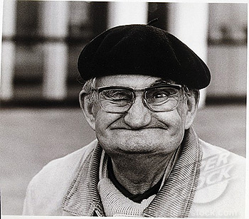
Tips for presentation
‘Right’ number of slides
Make notes – read or prepare the day of/before
Don’t just read (slides or notes)
Avoid jargon and information overload
Beware handouts
Be yourself (it was you who was invited to speak!)
“To err is human”

Slide 6
Tips for presentation
Rehearse – but not too much
Check ppt works accurately as a slide show
Recognise and respect your audience
Accept stage fright – don’t overthink it
Be prepared for questions – don’t fear them!
Have a plan in case you run out of time/have time left

Slide 7
Top tip
Never think that just because you know it, they must know it too.

Slide 8
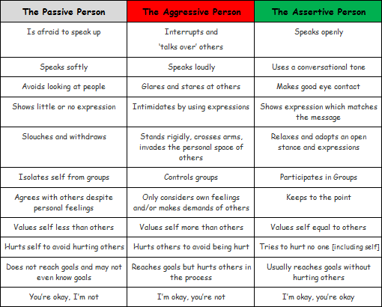
Some trip hazards
avoid too many bullet points
bullets can kill (presentations)
Don’t be predictable
Use text, bullets,grammar consistently
don’t put lots and lots of information itno very long sentences with lots and loots of meestakes that you then reed to yor audience wehn they are pefectly capable of redding it themsleves and who are now probbbayly heding for the door
check that pictures or graphs can be read clearly
don’t misunderstand or forget the brief

Slide 9
Presenting to SLT/governors?
“We don’t see things as they are, we see them as we are.”
Anais Nin

Slide 10
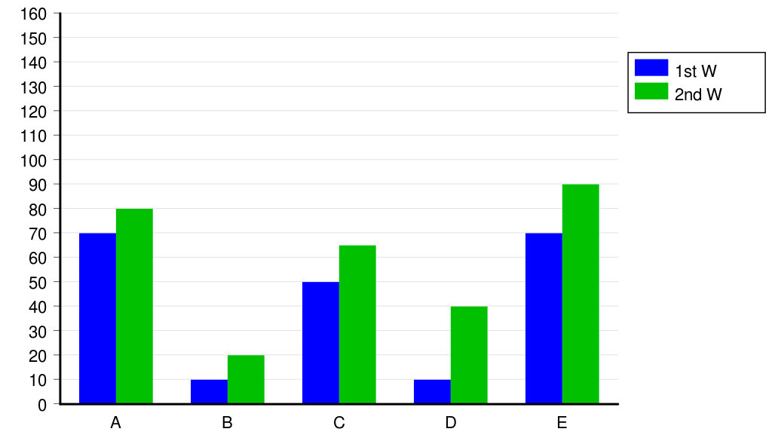
Make information accessible

Slide 11
Inset and team events
Know what you are aiming to achieve
Inset (half) days
Keep it targeted, and fun
Be the leader
Focus on the important
Expect barriers, but encourage enablers
Introduce ideas you feel comfortable/excited about
Involve others – don’t make it the ME SHOW!
Plan ahead – notes ideas as they occur to you

Slide 12
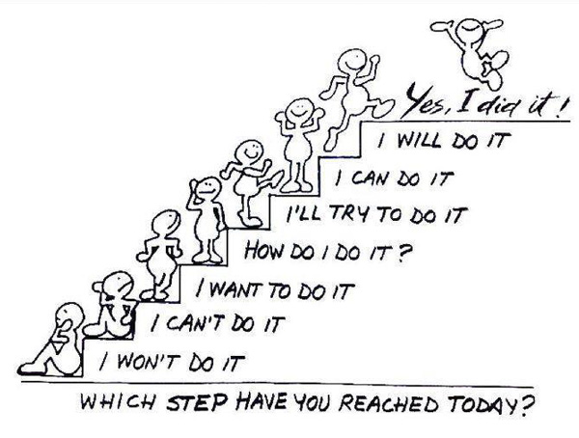
Growing confidence

Slide 13
External events
Get there in plenty of time
Take back-up ppt on memory stick
Gauge audience experience before your turn
Check who your audience is!
Watch and learn
Remember, just because you know it...

Slide 14
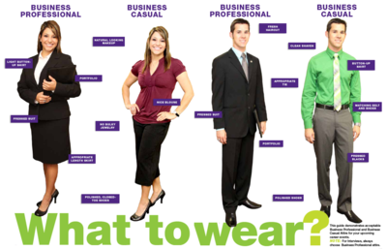
Dress to impress?

Slide 15
Consider your audience!

Slide 16
Focus on the mood lifter...

Slide 17
Summary

Slide 18
Summary

Slide 19
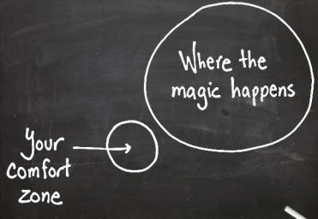
Summary

Slide 20
Find more resources at:
my.optimus-education.com/knowledge-centre/school-business-management
Follow us on Twitter:
@OptimusEd
Questions & Answers

