Slide 1

How to practically support pupils with bereavement including suicide
Tracey Boseley
National Development Lead for the Education Sector
Child Bereavement UK
Notes:
.

Slide 2
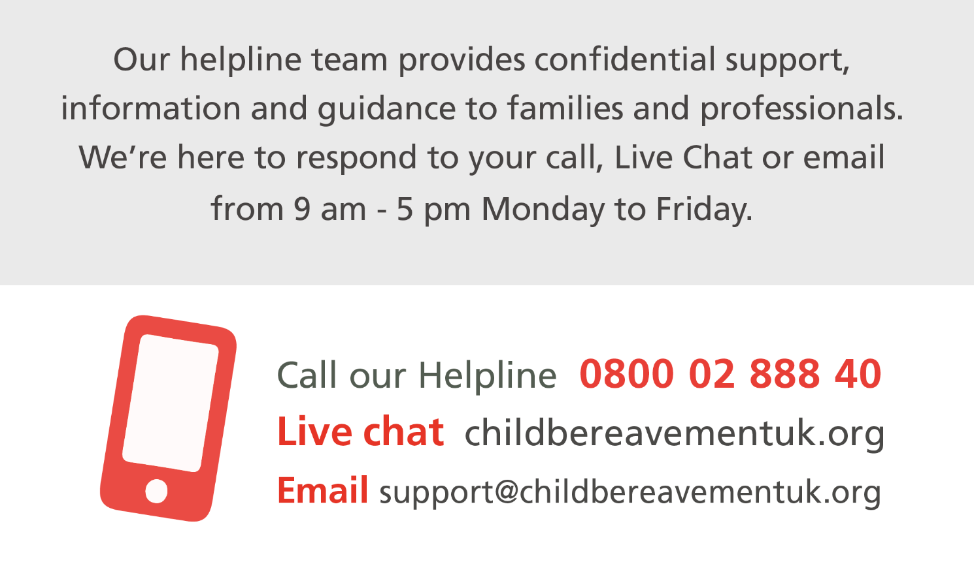

Live Chat

Slide 3
childbereavementuk.org

Slide 4
Bereavement
  Children’s understanding of death
  Theories of grief
  School role
  Suicide
Support
  Strategies
  What to consider
  Taking care of yourself
  Child Bereavement UK

Slide 5
Bereavement

Slide 6

Bereavement within the school community

Slide 7
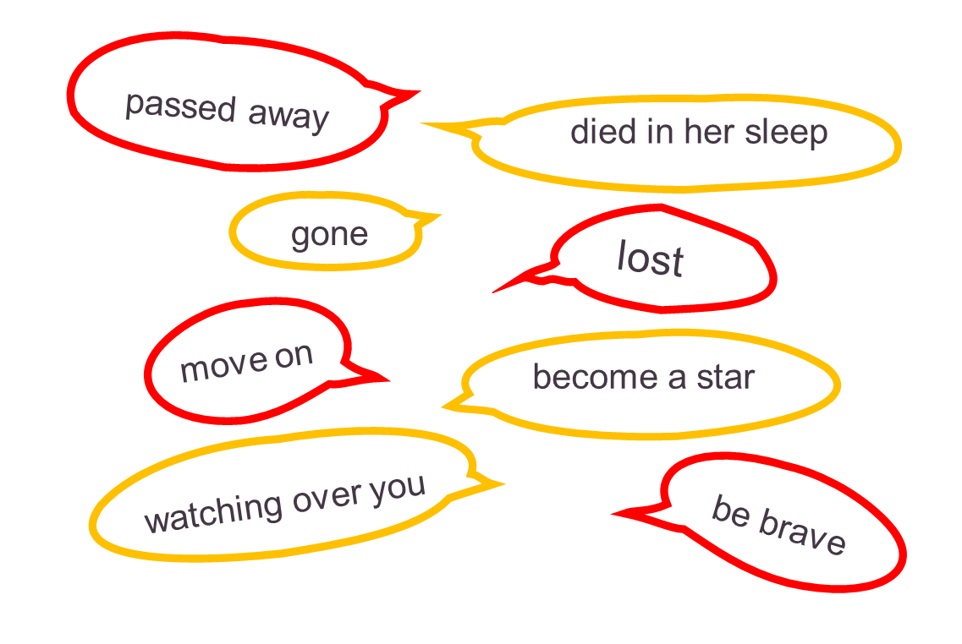

Euphemisms
What do they mean?

Slide 8




Children’s understanding
of death

Slide 9
Bereaved at
2 years old

Slide 10
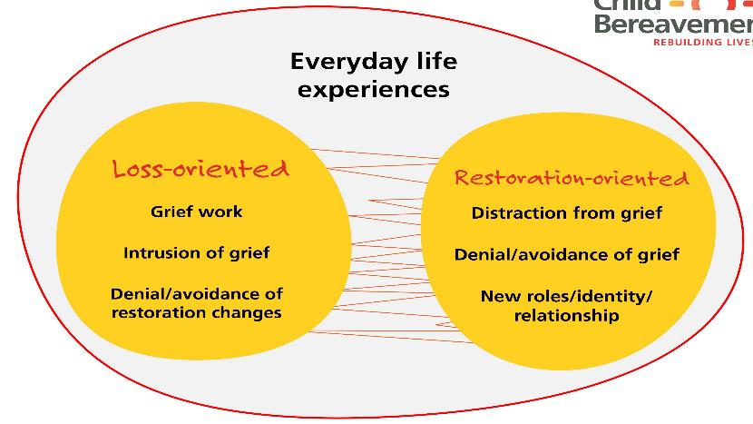
Worden’s
Tasks of Mourning
Stroebe and Schut
  Dual process model
Accept
Process
Adjust
Connection

Slide 11
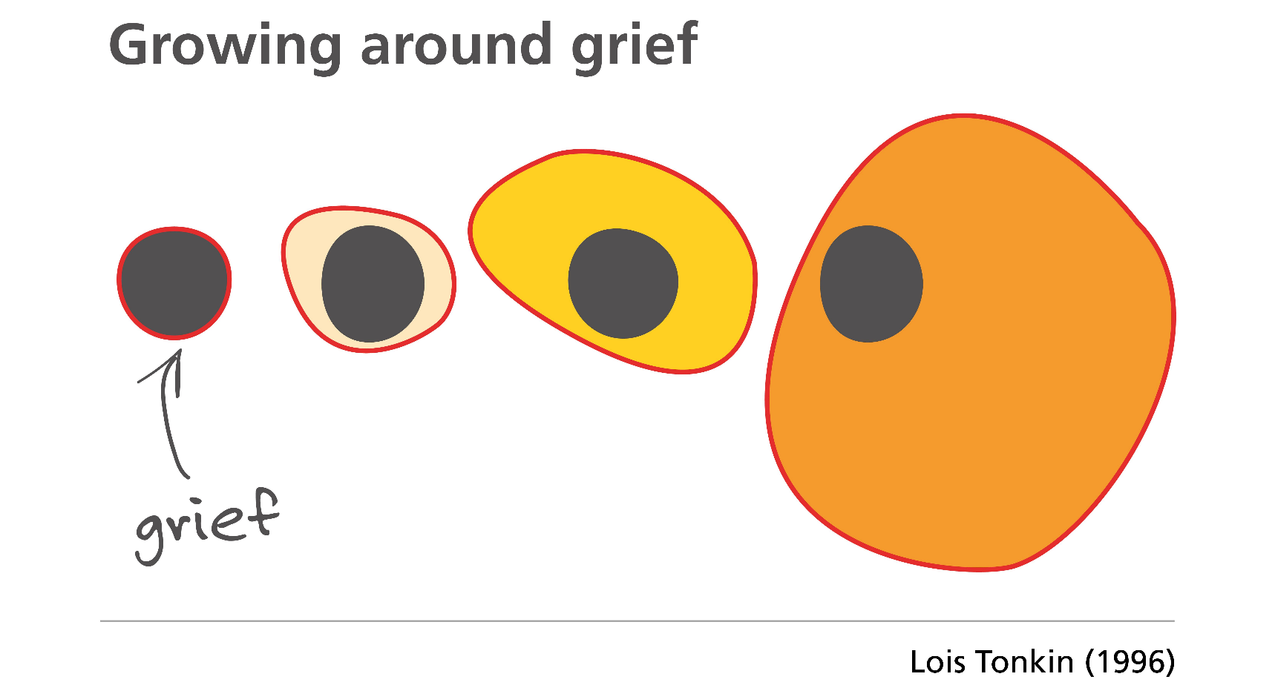

Slide 12
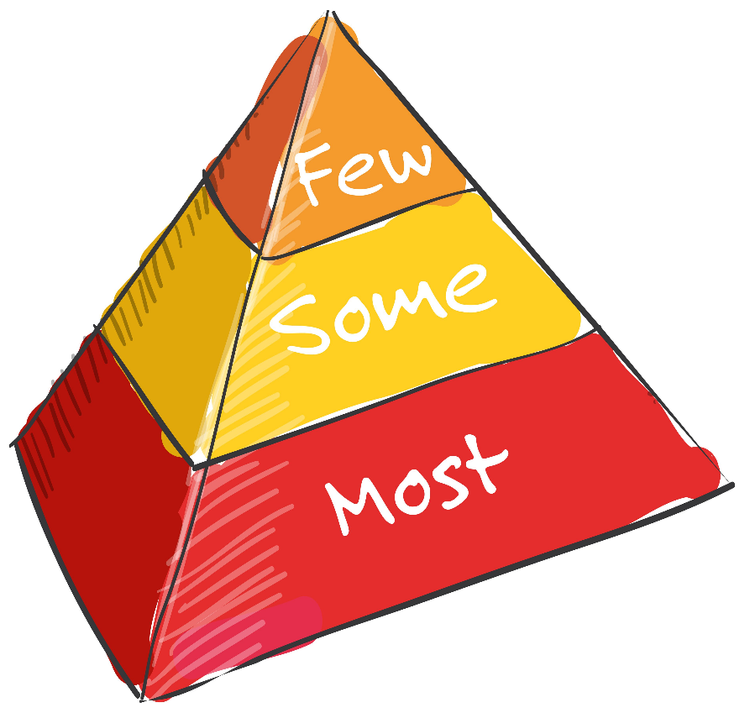
Few: specialist bereavement support for vulnerable or traumatised
Some: 1-2-1, family, peer or group bereavement support
Most: a supportive response from existing networks

Slide 13
Familiar and trusted adults
Routine
Being a child/young person
Refuge
Support
Community
School
A place of normality, stability and security for a grieving pupil

Slide 14

A school bereavement policy or charter

Slide 15

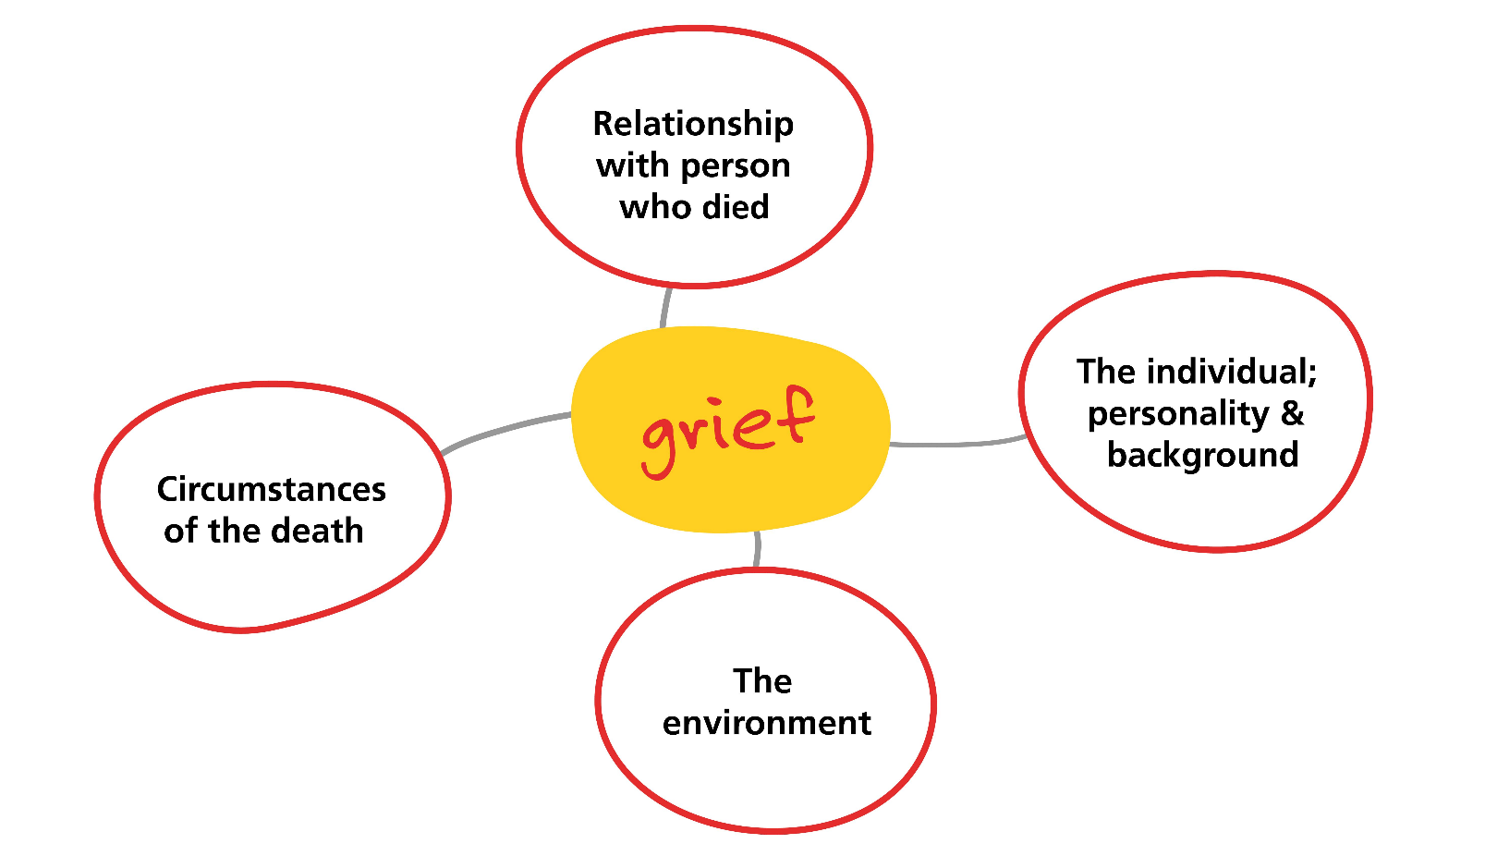

Slide 16


The language of suicide
Die/death by suicide
Take one’s own life
Help prevent suicide
A suicide
Commit suicide
Suicide victim
Just a cry for help
A successful suicide attempt

Slide 17
What behaviour might you see in these bereaved pupils?
ay
I don’t think anyone knows that my Mum died.
ay
All my friends talk about is gaming and sport; I just don’t fit in anymore.
ay
I’m struggling to concentrate and I can’t get my homework finished on time.
ay
I feel angry all the time.

Slide 18
Behaviour
Bereavement
Angry
  Physical, verbal, silent
Withdrawn
  Quiet, socially isolated
Under pressure
  Unrealistic targets
‘Trouble’
Managing grief
  Overwhelming feelings
Missing the person who died
Isolated and feeling different to peer group
Low self-esteem

Slide 19
Support

Slide 20





Slide 21













Slide 22

Acknowledgement
What do bereaved pupils want from school?
Understanding
I’m sorry to hear…
How can I…
What do you…
Tell me about…

Slide 23

Control
What do bereaved pupils want from school?
Space and Time

Slide 24






Honesty
What do bereaved pupils want from school?
Permission
I don’t know…
That’s a great question but…
What do you think?
Would you like me to try to find out?

Slide 25

Friendship group

Slide 26
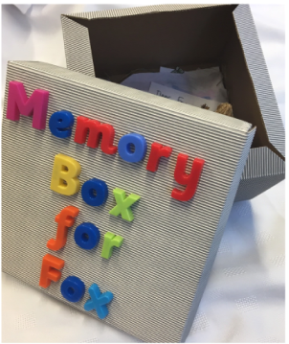


Activities and resources
Tool kits

Slide 27
Looking after yourself
Assess
Share
Emotions
Support
Time

Slide 28




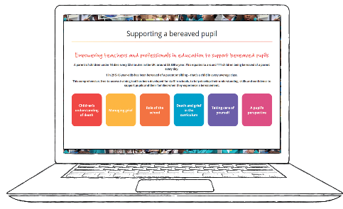

www.childbereavementuk.org
Support and information
Information sheets
Training
Short guidance films
Bereavement policy template
Information for parents and carers
Young people
Online resources
A guide for schools

Slide 29


