Slide 1
Webinar
Supporting pupils with anxiety: therapeutic techniques
Dr Tina Rae
Download this presentation from: http://oego.co/webinar-anxiety
Notes:
Dr Tina Rae has over 30 years’ experience working with children, adults and families in both clinical and educational contexts within local authorities and specialist educational services. She is currently working as a Consultant Educational and Child Psychologist in a range of SEBD/SEMH and mainstream contexts and for Compass Fostering as a consultant Psychologist supporting foster carers, social workers and Looked after children. She is also an Academic and Professional tutor for the Doctorate in Educational and Child psychology at the University of East London. She is a registered member of the Health and Care Professions Council and a full member of the British Psychological Society. Tina is also a member of SEBDA (Social Emotional and Behavioural Difficulties Association, ENSEC (European Network for Social and Emotional Competence) and, until recently, a trustee of the Nurture Group Network (NGN).
Tina is also a member of the editorial board for the SEBDA journal Emotional and Behavioural Difficulties and for the International Journal of Nurture in Education.
Tina is a prolific author and her 78 publications to date can be accessed via Sage publications, Paul Chapman publishing, Folens publishers, Jessica Kingsley, Speechmark, Routledge, Hinton publishers, NGN and Optimus publications. She is currently working on research into staff well-being and resilience and writing 2 books on this topic including - one which focuses in peer group supervision systems. Tina also contributes to national and international conferences and events on a regular basis including those for SEBDA, NGN, BSA and Optimus whilst also providing training courses and supervision for school based staff in both special and mainstream contexts and Educational Psychology services across the country and abroad.
tinarae@hotmail.co.uk

Slide 2
Why so important?
A key question for you? How do we do this?
Why do young people experience anxiety?
What do you think triggers these responses?
Why do they need to cope more effectively?
How can we use appropriate therapeutic techniques to effectively support them?

Slide 3
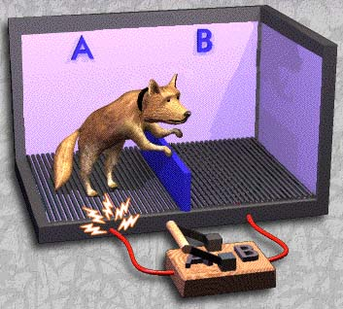
Notes:
This is a computer generated image [CGI] of a series of experiments by Martin Seligman in the late 60s – not very ethical!!
The apparatus was set up so an uncomfortable electric shock could be transmitted through one half or all of the floor, the barrier could be up, down or in the middle and the letters A and B were lights. It was expected that if a light came on to indicate that section A would have the shock in a few seconds, the dogs that had had the shocks would escape more quickly.
The opposite happened - dogs that had received shocks typically sat in the corner whimpering and made no attempt to escape even when it was very easy to do so.
This was termed 'learned helplessness' and was applied to humans experiencing depression [and anxiety].
We use this to ask young people with feelings of depression/anxiety: Is the problem mainly in the real world or mainly in your thinking? After a pause they say that it is mainly in their heads and they are 'catastrophizing' any existing stressor such as exams.

Slide 4
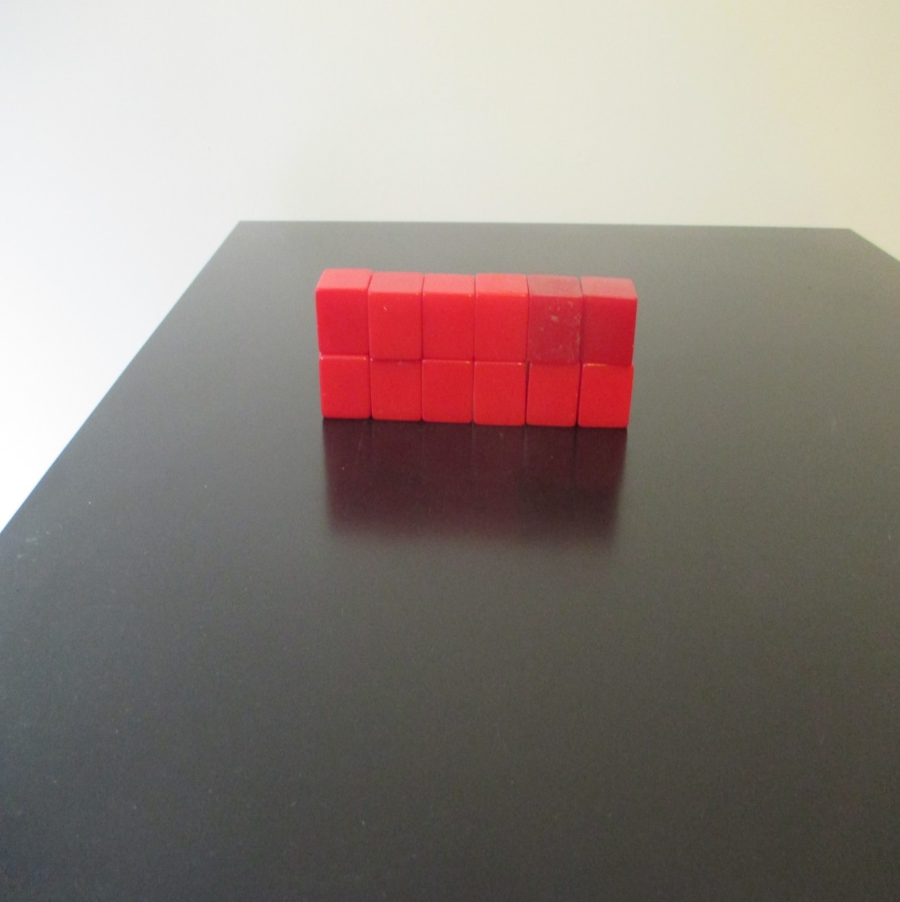

Slide 5
One young person who was anxious, described the anxiety as a ‘wall’…so we built a wall from toy bricks.
We then asked her to ‘reframe’ to think about the situation differently…

Slide 6
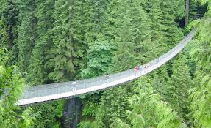
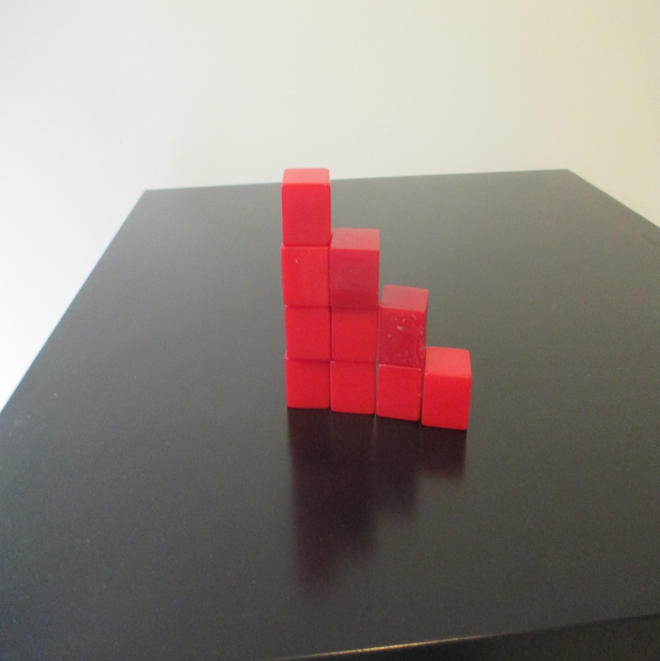
Notes:
…and she reframed the situation into steps so that she could deal with it all one step at a time.

Slide 7
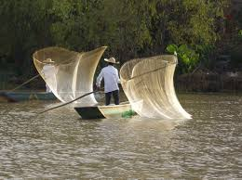

Slide 8
If I ask you to go fishing I cannot give you a rock-solid, cast–iron guarantee you will catch a fish. However if you don’t go, I can guarantee you won’t.
Try to take the steps forward, don’t apply learned helplessness.

Slide 9
What is anxiety?
Type of fear or strong feeling about a situation.
Thought of a threat or something which may go wrong in the future.
Causes fright and uncertainty.
Lasts a short time or can be prolonged.
Can affect our ability to eat, sleep, concentrate, travel, leave the house, go to school and work.
Can interfere with our enjoyment and take over our lives and control thoughts and behaviours.

Slide 10
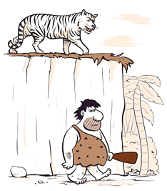
Anxiety
Anxiety is normal.
It’s a basis of survival because it prepares our bodies to cope with danger.
In moderate amounts it helps to improve our performance.
Natural performance enhancing drug
Adrenaline
Notes:
The purpose of it is to prepare our bodies to cope with danger.
This is the basic caveman survival instinct. It dates from prehistoric times and is found in animals too. It’s a normal healthy reaction to danger. Helps to improve our performance and survival. Adrenaline hormones are automatically released into our blood stream from glands near our kidneys [adrenal glands]. These chemical messengers tell our bodies to react more effectively.
We are all familiar with the performance anxeity chart…. Anx helps improve performacne to a point.. After which our performance decreases
So it can be useful… if I did not feel a little bit anxious about coming here to talk to you tonight I would probably not perform as well…. Anxiety can help us perform as long as we don’t feel too much anxiety..
10

Slide 11
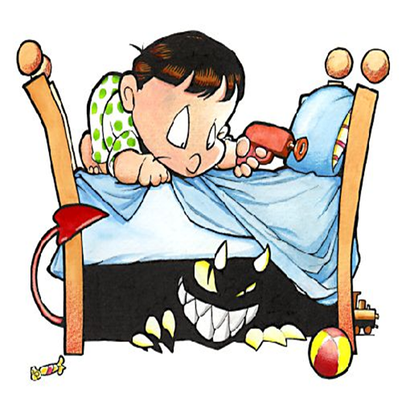
Why do we get anxious?
Sense fear
Extreme reaction to everyday events
Loss of control
Stress to a life situation
Release of adrenaline in the body
Preparation for an emergency
'Fight or flight' primitive response
Increase blood flow to muscles
Dilated pupils, increased muscle activity etc.
Notes:
Enza

Slide 12



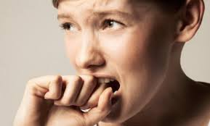
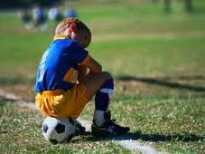
Anxiety in children

Slide 13
Triggers
After something bad has happened
Significant life events i.e. bereavement/illness/separation/bullying
Fears: Dogs, spiders, snakes, flying, wasps
Genetic predisposition – how we are made up
Temperamental disposition – how we behave
Uncertainty– A fear of having to do something new or out of our comfort zone.
Notes:
Enza

Slide 14

Defining resilience
‘Bounce-backability!’
‘Getting up , dusting down and starting all over again...’
‘We all know what resilience is until we try to define it’(Padesky 2009).
Inevitably a construct:
Socially, culturally and psychologically and personally constructed.
Definition = includes what is personally meaningful.

Slide 15
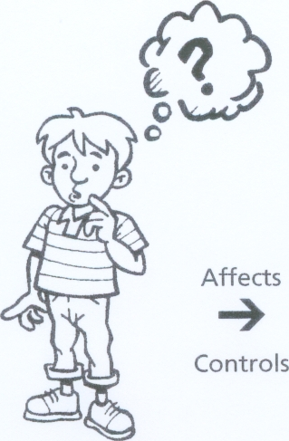
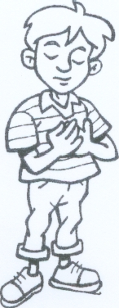
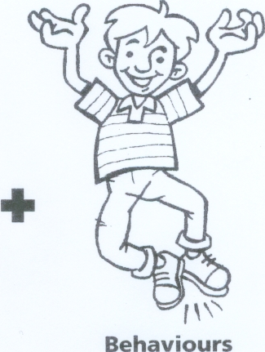
Inner thoughts…
The way we THINK influences
the way we FEEL and BEHAVE
Thoughts
Feelings
Notes:
NEPSNEPS North-West
15

Slide 16
The negative cycle
Thoughts
'I’m rubbish
at Maths'
More evidence:
'I told you I was
rubbish at Maths!'
Feelings
Anxious, sick, shaky during a Maths test
Behaviour
Freeze in the test
and fail
Notes:
Learning a new skill that we find difficult or challenging can lead to negative automatic thoughts/ skewed thinking errors popping into our heads. When these thinking errors occur, it can lead to an emotional reaction, which can be physical, for example feeling sick or teary. Our thoughts and feelings give rise to how we behave. Those difficult thoughts and feelings may lead us to perform poorly when learning the skill or to give up altogether. Our poor performance may be seen as evidence to support our original thinking error.
Emotions – unpleasant shifts in our feelings – are often the only trace that a NAT leaves in our consciousness - a fleeting sense of disappointment when unacknowledged by a friend, could be the surface manifestation of a key negative thought - nobody cares about me?
An emotion is often as much a physiological event as much as a psychological one:
Various hormones released by our bodies can have a profound effect on mood. HRT (mention pupil who told me about her mothers happy pills)
We know that making deliberate changes in our outward behaviour can influence our feelings, one study re daily smiling demonstrated how this affected mood positively.
Regular Exercise can affect a body’s serotonin levels in the same way as certain anti depressants.
What this means is that physical sensations and changes we experience in our bodies are often important sources of information about what we feeling and thinking.
So what effects can NATS have?
An initial negative thought can lead to a cycle of negative feelings, thoughts and behaviour which ultimately confirm an individual’s failure
Spot WHEN the thoughts occur, e.g. before a maths test
Note HOW they make us feel, e.g. sick, worried
Identify WHAT they make us do, e.g. not go into school on test day, make us freeze in the test
A key aim of CBT is to enable you to identify challenge and reframe NATS where they occur so you have more balanced thoughts about yourself, others and the world.

Slide 17
Cognitive distortions
We all tend to distort, discount or disregard information that contradicts our mood and our beliefs, e.g.
Paul Stallard (2003) – based on Beck
The downer Negative glasses. Positive doesn’t count. Blowing things up All or nothing thinking. Magnifying the negative. Snowballing. | Predicting failure The mind-reader. The fortune-teller. Feeling thoughts Emotional reasoning. Dustbin labels.
Setting yourself up to fail. Blame me!
Notes:
Run through slide then ask group to identify any cognitive distortions in the thoughts that they recorded either in Activity 1 or 2
The downer:
Negative glasses – only see the negative things, even if things go well. e.g. you have a good day out with friends but at lunch-time your favourite café was full. This is all you recall and report of the day.
Positive doesn’t count – rubbish the good things that happen and unreasonably tell yourself that positive experiences, deeds or qualities don’t count e.g. other team wins: they just got lucky, it doesn’t mean they’re any good or your team loses ' the referee was crap!'. I got a good mark in that essay, but that doesn’t mean I’m any good at the subject - I just got lucky.
Blowing things up:
Negative things become bigger than they really are
All or nothing thinking - view a situation in two categories rather than on a continuum e.g. you have a disagreement with your best friend and think to yourself ‘that’s it, I’m not their friend anymore’ OR If I’m not a total success, I’m a failure
Magnifying the negative – negative events are blown up out of all proportion e.g. ‘I forgot his name and EVERYONE was looking at me and laughing’ OR ‘I said something banal in a seminar and everybody noticed’.
Snowballing – a single event or upset snowballs and quickly grows into a never-ending pattern of defeat e.g. not being picked for the sports team could result in thoughts like ‘I’m no good at sports, I can’t understand maths, I just can’t do anything’.
Predicting failure:
Expect things to go wrong - predict the future negatively, without considering other more likely outcomes
The mind reader – person thinks that they know what everyone else is thinking e.g. ‘I know that she doesn’t like me’ OR ‘I bet everyone is laughing at me’.
The fortune teller – the person thinks that they know what will happen e.g. ‘If we go out, I’ll end up sitting on my own’ OR ‘I know I’m not going to be able to do this work’ OR ‘I’ll get so nervous, I won’t be able to do the exam at all’ OR ‘if we lose 10 matches in a row means they’ll definitiely be relegated’
Feeling thoughts:
With this thinking error, emotions become very strong and cloud the way that we see things. What we think depends on what we feel, not what actually happens
Emotional reasoning – because an individual feels sad or down, they assume that everyone else is – emotions taking over and colouring how they think
Dustbin labels – individuals attach a label to themselves and think about everything they do in these terms e.g. ‘I’m a loser’ OR ‘It’s me, I’m just hopeless’ OR ‘I’m rubbish’ OR ‘Because I got a bad mark in that essay, it means I’m a crap psycyhogist/student’

Slide 18

Red thoughts vs. green (powerful) thoughts
'I’m dumb'
'I’m ok at lots of things'
'I give up'
'If I try I’ll get better.'
'I hate my sister/ brother'
'I find my brother/ sister annoying sometimes,
but other times they are fun to play with'
'I have no friends'
'I have 2 people I play with and my dog is my friend'
Notes:
18
Tips for families
Encourage your child to focus on the positives of situations and not the negatives. Positive attention can be an essential first step in thinking positively.
Help your children to see life through a ‘positive’ lens, and to see the glass as ‘half-full’. This takes practice!
Help your child become aware of their self-talk and assist them in turning negative thoughts into positive and powerful thoughts.
Help your child practice bossing back unhelpful thoughts and replacing them with more positive thoughts.
Notice negative thinking in yourself or your child.
Young people model what they see and hear around them. If you recognise that you are saying unhelpful words or feeling tense or nervous then let your child know that you are aware of this. Then demonstrate coming up with an alternative positive way of looking at your situation.

Slide 19

Unhelpful red thoughts
I can’t do it
I am going to make a fool of myself
Why do I even bother
I give up
I hate Maths!
I’m hopeless
This is stupid
I don’t want to
What’s the point?
What if I make a mistake
This is too hard
I’m no good at this

Slide 20

Helpful green thoughts
I can try my best
I’m sure everyone finds this challenging
I’m going to give this
a shot
I’ll get there in the end
I can find a solution
I will be ok
This won’t be so bad
This could be fun
This is something different
It doesn’t matter what anyone thinks
I can cope with this

Slide 21
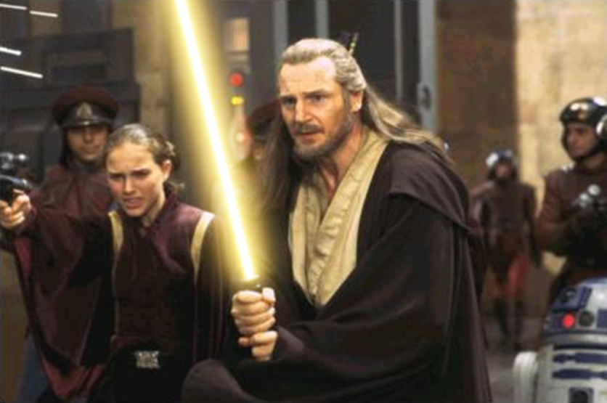
Thought challengers
Examples:
Is this really true?
Am I exaggerating?
Is this thought helping me?
Am I making things out to be worse that they really are?
What other explanations could there be?
It is sometimes difficult to change negative (red) to positive (green) thoughts.
Orange thoughts or questions can help us!

Slide 22
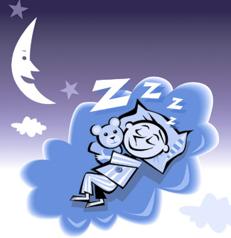
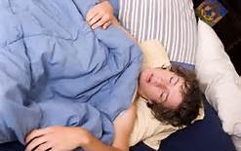

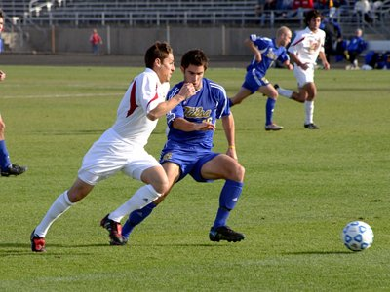


SLEEP and exercise!
Notes:
Essentials – think of exam stress management.

Slide 23



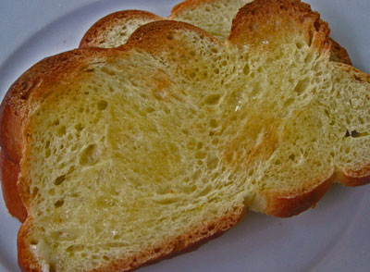
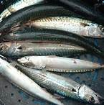
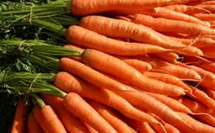
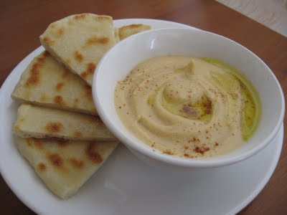
Healthy diet, active mind!

Slide 24
Skills training and therapeutic techniques for anxiety
Deep Breathing
Progressive Muscle Relaxation
Mental Imagery/Visualization
Systematic Desensitization
General Stress Busters
Cognitive Restructuring (CBT)
Notes:
Go through each one briefly – will be in more depth at Optimus conference.

Slide 25
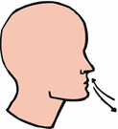
Deep breathing
Breathe from the stomach rather than from the lungs.
Can be used in class without anyone noticing.
Can be used during stressful moments such as taking an exam or while trying to relax at home.

Slide 26

Progressive muscle relaxation
Alternating between states of muscle tension and relaxation helps differentiate between the two states and helps habituate a process of relaxing muscles that are tensed.
Many good tapes, CDs and APs available on relaxation.
Especially useful for teenagers/top KS2.

Slide 27

Mental imagery/visualization
Can enhance other relaxation techniques or be used on its own.
Provides relief from troubling thoughts, emotions, or feelings.
Evokes a pleasing, calming mental image (e.g., the beach, park, forest, playing with a favourite pet).

Slide 28

Systematic desensitization
Anxiety reducing strategy involving exposure of the phobic person to the feared object or situation.
The person learns to tolerate the feared object by means of a series of steps beginning with the least anxiety producing aspect of the process and ending with the most difficult step.
Construction of the Anxiety Hierarchy.

Slide 29

Cognitive restructuring
Change cognitive distortions (irrational negative thoughts and beliefs someone has about different situations) and to increase positive self talk.
Steps:
recognise and get rid of negative self talk
counter the negative thoughts with realistic positive self talk
believe the positive self talk!

Slide 30

More strategies: thought stopping
Replaces 'racing thoughts' or disturbing thoughts with neutral thought.
Neutral thought – e.g., something positive and affirming; relaxing location.
Thoughts can be 'stopped' by practicing an abrupt interruption of thought – e.g., shouting 'stop!'
Return to thinking only about the neutral situation.

Slide 31

Activity scheduling
Scheduling enjoyable and goal-directed activities into your day:
assists withdrawn pupils reengage in pleasurable activities
provides the person with the opportunity to feel more effective as he or she completes tasks such as school projects.
We all need to be educated about the relationship between involvement in an activity and improvement in mood.
Think – what would you schedule in to your day?

Slide 32
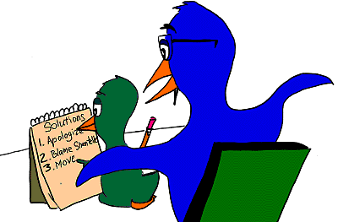
Problem solving
Problem solving assists pupils in generating solutions to problems.
Only focus on one problem at a time.
Steps:
  define the problem
  brainstorm all possible solutions
  focus your energy and attention to be able to complete your task
  identify outcomes related to the various solutions, including who will be affected by the outcomes
  make a decision and carry out
  have a contingency plan in case the solution does not work out as planned
  evaluate the outcome.

Slide 33

Busy mind vs. quiet mind
Notes:
Use of RELAXATION AND MINDFULNESS – KEY TOOLS WE ALL NEED TO USE.

Slide 34
Mindful starter
Look at this picture for 1 minute.
Do not think about anything else.
Simply observe it in all it’s splendour for one full minute.
Taken from ‘60 Mindful Minutes’ by Tina Rae

Slide 35
Mindful minute 5 train track – observe your thoughts to reduce stress
Sit quietly and imagine you are on the top of a hill.
Look down and see the train track picture of a train moving past.
As you see each carriage go past, think of it as one of your thoughts.
If you get caught up in your thought and feel as if you’ve jumped onto the carriage, gently get back up to the top of the hill.
Let that thought ‘go’ – notice it but don’t get on the carriage.
Notes:
FROM 60 MINDFUL MINUTES

Slide 36
Happiness boosters
Journaling
Expressing Gratitude
Exercise
Volunteering
Savoring Happy Memories
Surround yourself with 3 ‘P’s’ Photos, Plants, and Pets
Forgiveness
Meditation
Rituals
Positive relationships – no blood suckers!
WHAT WILL you do?
Your brain grows like a muscle!

Slide 37
Final thoughts
HELP YOUNG PEOPLE TO DEVELOP THER OWN PERSONAL ANXIETY MANAGEMENT PLAN.
What will you include from the key strategies and techniques presented today?
Who will help and support YOUR PUPILS in this?
What are the implications for staff roles and training?

Slide 38
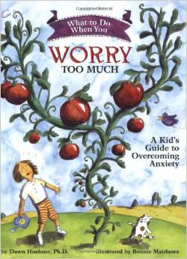
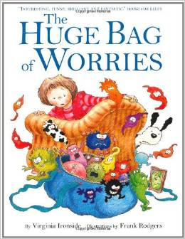
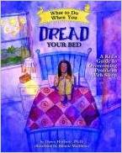
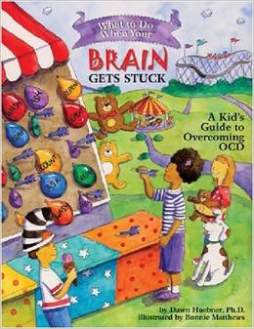

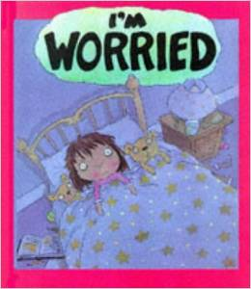
Notes:
Use available literature.

Slide 39




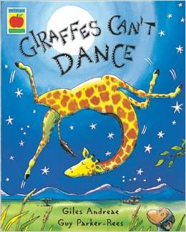


Slide 40

References
Thank you for listening and participating
Corey, G.(2008). Theory and Practice of Group Counseling (7th ed.). Belmont, CA: Brooks/Cole.

Slide 41
Helpful sites for parents, staff and students
Relate
http://www.relate.org.uk/relationship-help/help-family-life-and-parenting/family-common-problems/coping-disruptive-teenagers?utm_source=google-grants&utm_medium=cpc&utm_content=Family%20Life%20-%20Teens&utm_campaign=Relate
Young Minds
http://www.youngminds.org.uk/for_parents
Royal College of Psychiatrists
http://www.rcpsych.ac.uk/healthadvice/parentsandyouthinfo.aspx
NHS Choices
http://www.nhs.uk/Pages/HomePage.aspx

Slide 42
References for mindfulness
For exercises:
http://www.just-a-minute.org
http://www.mindfulnessinfo.com
Publications:
Wherever You Go, There You Are Jon Kabat-Zinn-
Dialectical behavior therapy skills, 101 mindfulness exercises and other fun activities for children and adolescents. Christensen, K., Riddoch, G. N., & Eggers Huber, J. (2009). Indiana: AuthorHouse.
60 Mindful Minutes – Tina Rae – NGN

Slide 43
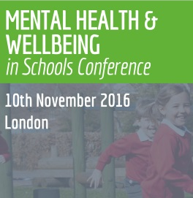
Mental Health and Wellbeing Conference 2016
‘Better provision of child mental health services, both in and outside school, is still sorely needed.’
What can I expect on the day?
Gain clarity on the future of CAMHS, the new role of the mental health lead and what a whole-approach should look like.
Anxiety
Now the fastest growing illness in the under-21s, gain techniques and strategies taken from therapeutic approaches to help students manage their anxiety and stress.
Resilience
New ideas to use with students to equip them with the skills to cope with adversity, challenge and failure and help build resilience.
http://www.healthinschoolsuk.com/
#oeMH16

Slide 44
Find more resources at:
http://my.optimus-education.com/knowledge-centre/sen-and-safeguarding
Follow us on Twitter:
@OptimusSEND
Questions & Answers

