Slide 1
Webinar
How to excel in middle leadership:
Taking the next steps towards progression
Louise Ishani, Head of Training (South), Teaching Leaders
Download this presentation from http://bit.ly/IshaniL

Slide 2
Teaching leaders’ mission & vision
Teaching Leaders’ vision is of a better society: one where life chances are not predetermined by social class, nor shackled by educational disadvantage. In the belief that children’s success at school can be driven not by social background but by the quality and kind of education they receive, we want to strengthen the capacity of those who lead teaching and learning closest to the action on the front line of challenging schools: middle leaders.
Our Vision
Teaching Leaders’ mission is to address educational disadvantage by growing a movement of outstanding middle leaders in challenging schools.
Our Mission

Slide 3
Agenda
What makes an outstanding middle leader - an opportunity to learn and reflect upon and develop your understanding of:
key characteristics of great leaders
models of effective middle leadership in schools
what middle leaders are accountable for and the professional characteristics they should display
why it is important to create a vision for your area of responsibility as a middle leader.

Slide 4
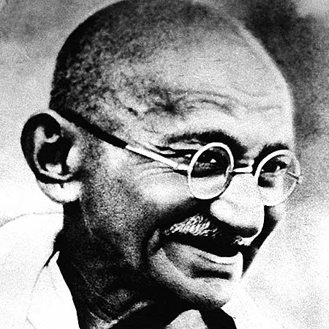
Mahatma Gandhi
Barack Obama

Slide 5
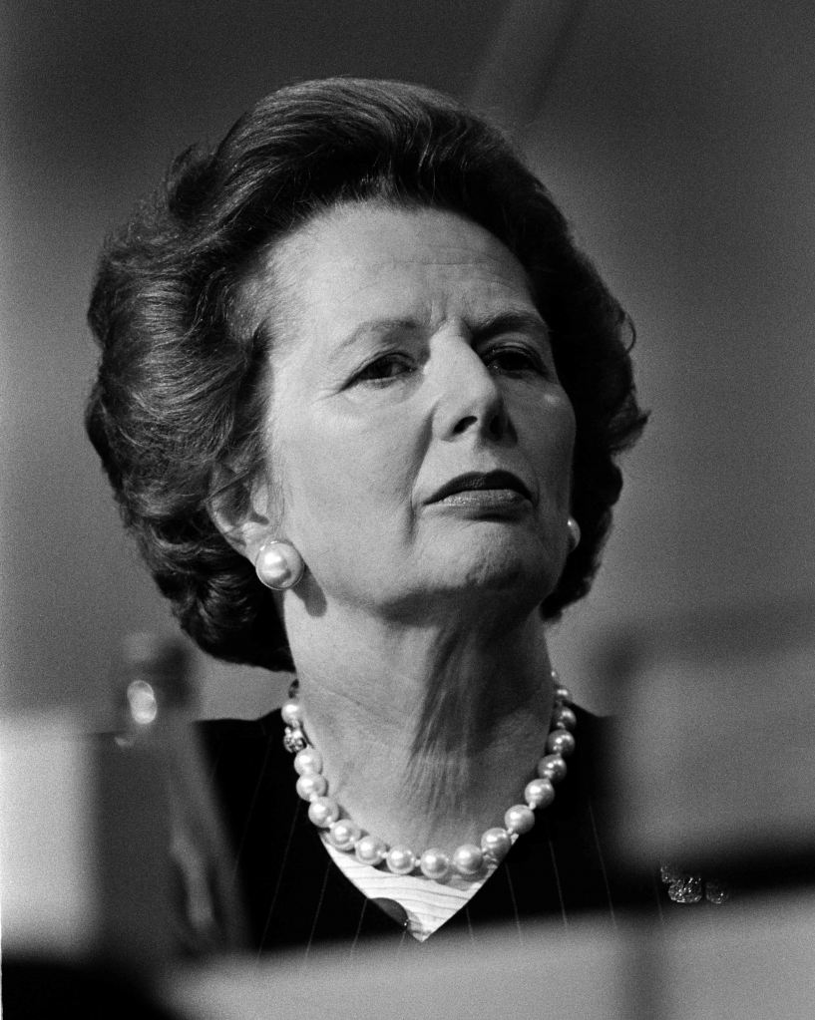
Margaret Thatcher
Alan Sugar
The lady is not for turning

Slide 6
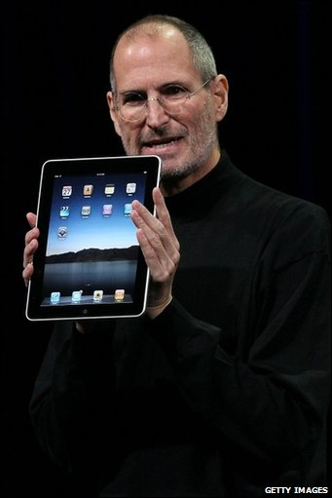
Martin Luther King Jr.
Steve Jobs

Slide 7
What is leadership?

Slide 8
Role of middle leaders – what you do
Future
Set the strategic direction
Plan and organise
Create alignment
Task
LEAD
People
Deliver results and get things done
Create teams
Build and sustain relationships
Now
Leadership - all you need to know Pendleton and Furnham - 2012

Slide 9
Hay model of leadership effectiveness
Create the vision
Understanding
Self and Others
Getting People on Board
Personal Values
&
Passionate Conviction
Monitoring & Improving
Planning for Delivery
Gathering Information
& Gaining Understanding
Government OFSTED LEAS
Staff, Parents, Governors, Pupils
Community, Employers,
Police,
Social Workers

Slide 10
What does the day job look like?
Teaching and Learning
Progress of Students
schemes of work
lesson observations
lesson planning
pedagogy Empathy
high expectations
inspiring
exemplary own practice
data
high standards
rigorous
uncompromising
goal focused

Slide 11
What does the day job look like?
Leadership & management
of my area
Relationships
performance of team
succession planning
vision
building capacity
CPD empathy
Vision
strategic thinking
all parents
Head/SLT
other stakeholders (social workers/PRU)
team
empathy
good communicator

Slide 12
Leadership accelerators: the 11 competencies that differentiate a good from a great middle leader
Moral purpose
Personal drive
Self-awareness
Resilience and emotional maturity
Impact and influence
Holding to account
Developing others
Curiosity and eagerness to learn
Conceptual thinking
Relating to others
Inspiring others

Slide 13
What is expected of middle leaders?
Ofsted criteria for the quality of leadership and management of the school https://www.gov.uk/government/uploads/system/uploads/attachment_data/file/391531/School_inspection_handbook.pdf
National Standards for Teachers
Demands of context - role functions and challenges within school
Self review - school improvement plan
Stage of development of your team

Slide 14
Key questions for prospective middle leaders
What vision would you have for the leadership area you are interested in?
How would you articulate it?
What is it about your vision that will inspire others to follow it?
What will the impact be ?

Slide 15
Inspiring a shared vision: Kouzes
Envision an uplifting, exciting, meaningful future.
Enlist others in a common vision by appealing. to their values, interests, hopes and dreams

Slide 16
Elevator pitch
You have 60 seconds to convince a headteacher of your vision for an area you would like to lead as a middle leader.
What would you include?

Slide 17
Structuring an elevator pitch
Identify your goal
Explain what you do
Communicate your uniqueness/interests
Engage with a question
Put it all together
Practice

Slide 18
Time to reflect
What will you take away from this session?
What actions will you take in the next six months to help you in your progression towards being a highly effective middle leader?

Slide 19
A final quote and speech
“The role of middle managers is crucial to the steady and sustained improvement of schools. The Headteachers and senior managers provide the vision but middle managers effect the long-term changes, which will raise standards and improve the quality of education.”
Ofsted
Further reading:
Speech by Sir Michael Wilshaw on the importance of middle leadership:
http://www.teachingleaders.org.uk/sir-michael-wilshaws-manifesto-for-middle-leadership-speech/

Slide 20
Questions & Answers
Find more resources at
http://www.optimus-education.com/knowledge-centre/leadership-governance
Follow us
@LeadershipOE

