Slide 1

Mental Health Teaching Checklist
Dr Pooky Knightsmith

Slide 2
Quick Links
(click to access relevant slide)
Familiarise yourself with school policies
Set specific aims and objectives
Consider vulnerable pupils
Distance the learning
Negotiate ground rules
Consider likely questions / misconceptions
Invite questions before and after the lesson
Signpost support
Inform staff and parents
First do no harm
Overview checklist

Slide 3
Teaching about Mental Health
Teaching pupils about mental health and emotional wellbeing as part of a developmental PSHE Education programme can support them in developing the skills, language and knowledge they need to keep themselves safe.
These guidelines are designed to help you ensure the safety of your pupils when addressing these topics. You are welcome to contact me for further advice.
Good luck!

Slide 4

Familiarise yourself with school policies
Your lessons are likely to result in disclosures from pupils concerned about their own wellbeing, or the wellbeing of a friend. Make sure you are fully aware of the policies and procedures you should follow if a pupil confides in you. If policies are not fit for purpose or procedures are unclear, this should be highlighted with the relevant member of staff.

Slide 5

Set specific aims and objectives
You wouldn’t plan a maths lesson without clear aims in mind, the same should be true of a PSHE lesson. Think carefully about the ways in which you want pupils to advance their:
Knowledge
Language
Understanding &
Skills
And have a clear plan for achieving this.

Slide 6

Consider vulnerable pupils
Plan every lesson based on the assumption that at least one pupil will have been personally affected by the issues the lesson draws on. This will ensure you keep every pupil safe.

Slide 7

Distance the learning
Use distancing techniques to prevent the lesson feeling too personal for pupils. Ideas that work well include:
Case studies
Role play
Puppets

Slide 8

Negotiate ground rules
Either reinforce or introduce ground rules for the lesson. These work best when negotiated with pupils, though you may need to steer the conversation. Suggested topics you could explore are listed on the next slide.

Slide 9
Ground Rules to Consider
Openness
Keep the conversation in the room
Non-judgmental approach
Right to pass
Make no assumptions
Listen to others
Use of language
Ask questions
Seeking help and advice
Notes:
Establish or reinforce clear ground rules
You could negotiate them with pupils
Be consistent in your application
Signpost further support

Slide 10

Consider likely questions / misconceptions
You’ll feel more confident leading a lesson on a difficult topic if you’ve prepared yourself for the different scenarios that might arise and the questions you may face. You can do this both by reading around the topic and by thinking about misconceptions you have heard in the playground, staffroom or the media recently.

Slide 11

Invite questions before and after the lesson
Allow pupils to anonymously submit questions before and after the lesson. This will allow you to prepare answers and will allow pupils to ask questions they feel unable to ‘own’ in front of peers.

Slide 12

Signpost support
Locate sources of school, local and national support. Highlight these with pupils and explain how they can be accessed. Be sure also to explain what is likely to happen if a pupil seeks support as this can be a great cause of uncertainty.

Slide 13

Inform staff and parents
Pupils are far more likely to seek support for their mental health concerns following a lesson on the topic. Therefore, it’s important that you make staff and parents aware of the fact the topic is being covered and ensure they know how to support appropriately.

Slide 14

First do no harm
When you think your lesson is ready, review it with critical eyes and share it with a trusted colleague and make sure you are confident that you can teach the topic confidently and safely.

Slide 15
Teaching Checklist Recap
Familiarise yourself with school policies
Consider vulnerable pupils
Distance the learning
Set specific aims and objectives
Negotiate ground rules
Consider likely questions / misconceptions
Invite questions before and after the lesson
Signpost support
Inform staff and parents
First do no harm

Slide 16
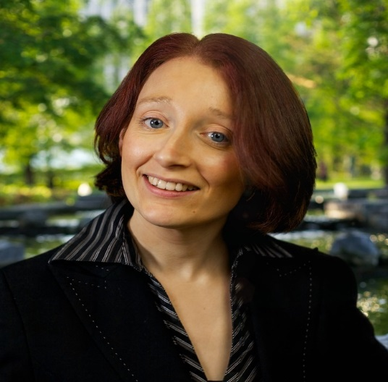
Need more support?
Dr Pooky Knightsmith specialises in mental health and emotional well-being in the school setting. She can provide training sessions or workshops for school staff, parents or students on a variety of topics, including self-harm, anxiety, body image and eating disorders.
For further information and free resources visit
www.inourhands.com
Email: pooky@inourhands.com
Twitter: @PookyH
LinkedIn: linkedin.com/in/pooky
**If you would like an editable version of this PPT please email me**

