Slide 1
Webinar
Creating an effective EAL Policy
Di Leedham
English, Literacy and EAL teacher and consultant
@dileed
Download this presentation from http://bit.ly/EALslides

Slide 2
The importance of developing an EAL Policy
In England currently 19.4% primary, 15% secondary are EAL learners. ISC research indicates that there are now over 8,000 international schools teaching 4.26 million students in English.
Much variation within and across regions and across pupil groups with complex interwoven issues of social, cognitive and academic development.
Strong contextual suggestion of benefit for all pupils when EAL is a central focus of planning and provision. Simultaneous bilingualism is an asset to be encouraged.

Slide 3
An EAL Policy is an opportunity to engage in an evaluative process of enquiry
?
?
EAL
Policy
EAL Provision
?

Slide 4
EAL Policy at the heart of your school
Who has an overview of EAL links and overall ownership and accountability for EAL learners?
Safeguarding Policy
Pupil/family/extra curricular provision/spaces
Transition and Admission Policy
Inclusion Policy
EAL
Policy
SEND Policy
CPD Policy
School leadership and whole school spaces/provision
Teachers and classroom spaces/provision
Assessment Policy
Teaching and Learning Policy

Slide 5
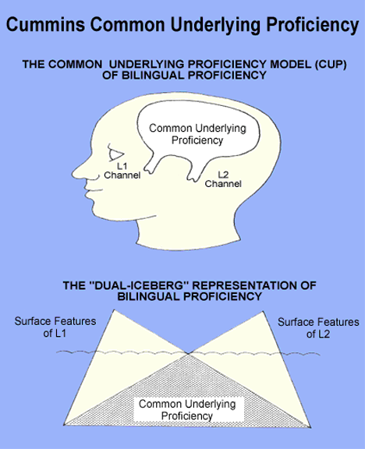
EAL Policy: Values and vision
Do all your teachers know and accept these research supported statements?
Simultaneous bilingualism is the best possible individual outcome for a learner and a community asset.
The quality of English experienced by an EAL learner counts for more than quantity.
Fluency/literacy in other language/s known is a factor in development of English.

Slide 6
EAL Policy: What about first language/s ?
Does your school provision reflect what research tells us about the benefits of bilingualism?
Do your teachers make confident and consistent decisions about use of first language/s in the classroom?

Slide 7
EAL Policy: What do we know about our EAL pupils?
EAL learners in any context are not a homogenous group.
L1 fluency/literacy, prior experience of schooling, time/context of learning English and social/emotional factors all play a part.
How accurate and detailed is the information recorded about your individual EAL learners?
What is shared with teachers and do they understand and use the information effectively?
Class List
Name | Form | Gender | EAL
Ahmed | 7U | M | ✓
Barry | 7U | M | x
Celeste | 7U | F | ✓

Slide 8
EAL Policy: Consistent EAL aware pedagogy
Do your teachers have a shared understanding of how to plan/deliver lessons for EAL learners?
Comprehensible input.
Appropriate cognitive challenge.
Language aware pedagogy to develop English fluency.

Slide 9
EAL Policy: Further reading and links
EAL Mesh Guide http://www.meshguides.org/guides/node/112
NALDIC http://www.naldic.org.uk
EAL Nexus https://eal.britishcouncil.org
Professor Steve Strand https://www.unboundphilanthropy.org/sites/default/files/EAL_and_educational_achievement2_0.pdf
The Collaborative Learning Project http://www.collaborativelearning.org
The Multilingual Creativity Hub http://www.multilingualcreativity.org.uk
The National Resource Centre for Supplementary Education http://www.supplementaryeducation.org.uk/supplementary-education-the-nrc
EAL model policy http://my.optimus-education.com/eal-model-policy
Developing first language in the classroom http://my.optimus-education.com/eal-teaching-using-pupils-first-language-mainstream-classroom
EAL teaching and learning principles http://my.optimus-education.com/eal-teaching-principles-good-practice

Slide 10
Find more resources at
http://my.optimus-education.com/knowledge-centre/teaching-and-learning
Follow us
@TeachingOE
Questions & Answers

