Slide 1
GDPR: How to ensure a culture of compliance
Dai Durbridge

Slide 2
Understanding why behaviours and practices need to change
Types of behaviour that may well breach GDPR
How best to change behaviours to ensure compliance

Slide 3
The basics
Up to €20,000,000 fine
Get your policies and other docs in order
Appoint your DPO
All achievable by 25 May 2018 and gets you 80% of the way there

Slide 4
The basics
The final 20% is the culture change
Not going to be achieved in next nine weeks
Need longer to win hearts and minds

Slide 5
Why behaviours and practices need to change

Slide 6
Behaviours and practices change
Up to €20,000,000 fine
Accountability and compliance focus under GDPR
“Keep it just in case” mantra
Privacy and data security not at the forefront of minds

Slide 7
Behaviours and practices change
Rely too heavily on broad consent for our reason for processing
Moving to a regime where privacy and data security need to be thought about with the same seriousness as safeguarding in schools

Slide 8
Types of behaviour that breach GDPR

Slide 9
Types of behaviours
USB pen drives
Member of staff downloads personal data onto USB drive and loses it.
Would the member of staff tell you…?

Slide 10
Types of behaviours
Subject access request
You receive an email from Jeffhughes@hotmail.com asking for copies of his records (former pupil)
Do you provide them?
Is he who he says he is?
Paranoia, adversarial, distrusting

Slide 11
Types of behaviours
Governor using personal email address
Governor emails your lawyers from her slinkysue@gmail.com account with the subject line ‘dismissal of headteacher’ and content including allegations, salary and proposed settlement terms
Problem?

Slide 12
Types of behaviours
Downloading onto home computer
Staff member remotely accesses the school system and downloads safeguarding information to his home computer
What are the risks?

Slide 13
Types of behaviours
Leaving laptop in the car overnight
Teacher has a school laptop and leaves in the car overnight. The car is broken into. The laptop is password protected, but the password is ‘password’. It is not encrypted.
Does this sound realistic?
What’s on the laptop? What are the risks?

Slide 14
Types of behaviours
Emails accessed on personal phone
Staff member confirms that absolutely no one else can access the phone…accept her husband and the kids to play games. Assures you they’d never look at her emails…
Is this a risk?

Slide 15
How best to change behaviours to ensure compliance
Dai Durbridge

Slide 16
Changing behaviours
A balance to be struck between changing behaviours and adding safeguards to existing behaviours
May not need to stop anything, but may need to build processes and procedures around approaches to ensure and evidence compliance
Some behaviours will need to change

Slide 17
Changing behaviours
Case studies:
USB pen drives
governor personal email addresses
downloading onto home computer
laptop in car
emails on personal phone.

Slide 18
Changing behaviours
Can’t change behaviours overnight
Has to be done at the right time at the right pace in the right way
Unlikely to be achieved in the next nine weeks

Slide 19
Changing behaviours
Don’t mention GDPR
Position it as changing working practices to make staff lives better
Remote working
Not lugging documents around
Heightened security to protect their own hardware

Slide 20
Changing behaviours
Help them with new skills
How to guides
Top tips
Do it for them!
Outcome is more important than timeframe

Slide 21
Outcomes
All about the evidence
Review how staff are trained and how regular updates are provided
Think about ways to engage staff and evidence outcomes:
staff quiz
survey monkey
questions in team meeting
plenty of others.

Slide 22
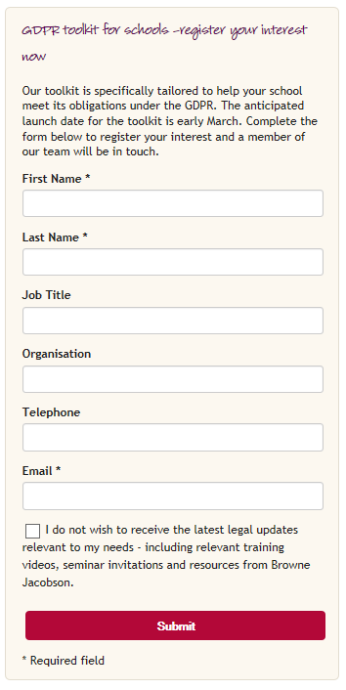
Our tookit
https://www.brownejacobson.com/education/products/gdpr-toolkit-for-schools
Browne Jacobson GDPR toolkit for schools
£700 plus VAT
£575 plus VAT for Optimus members
Available next week

Slide 23
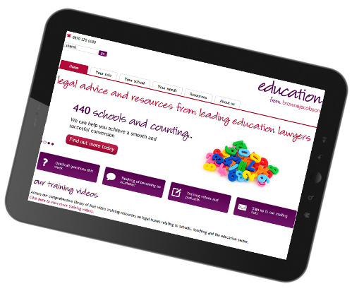
www.brownejacobson.com/education

Slide 24
Please note
The information contained in these notes is based on the position at March 2018. It does, of course, only represent a summary of the subject matter covered and is not intended to be a substitute for detailed advice. If you would like to discuss any of the matters covered in further detail, our team would be happy to do so.
© Browne Jacobson LLP 2018. Browne Jacobson LLP is a limited liability partnership.
Dai Durbridge| 0330 045 2105| dai.durbridge@brownejacobson.com

