Slide 1
Webinar
Time saving differentiation strategies
Amjad Ali - @ASTSupportAAli

Slide 2
My definition...
The term differentiation refers to anything you do that accommodates differences in your learners, leading them to learn effectively.
OR
Know your students

Slide 3
TEACH MEET STYLE!

Slide 4
Backward planning
Start with the end in mind: plan for learning. Establish a clear objective and tangible outcomes

Slide 5
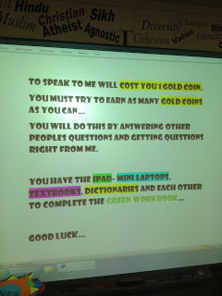
Students as resources

Slide 6
I wish my teacher knew

Slide 7
So that...

Slide 8
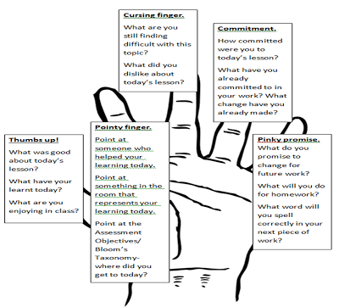
Hands Down

Slide 9
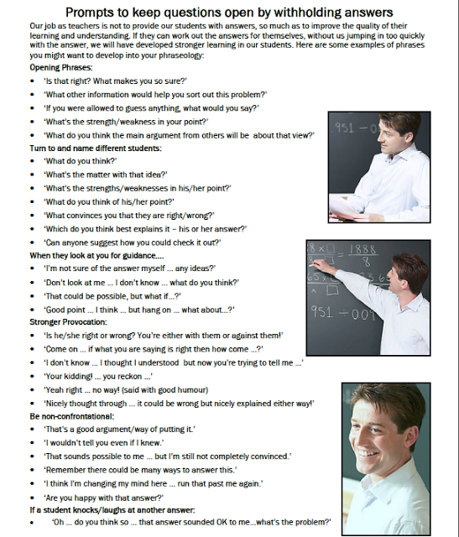
Questioning
Develop your
skills
Practice
Rehearse

Slide 10
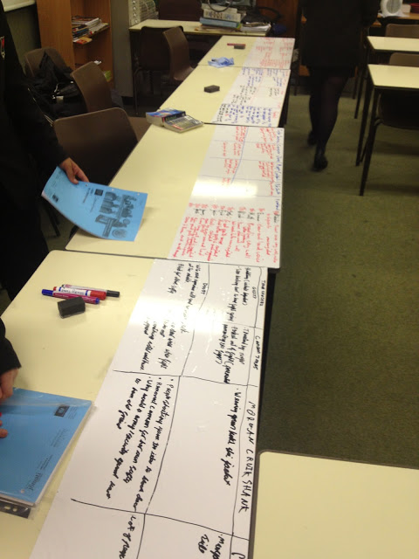
Whiteboards

Slide 11
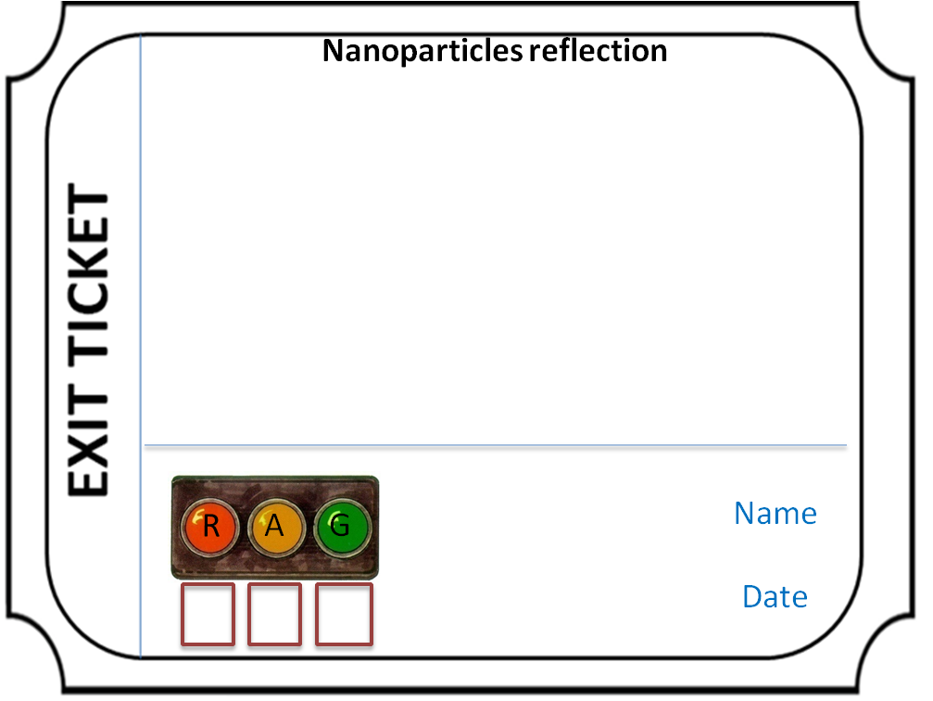
Exit Tickets

Slide 12
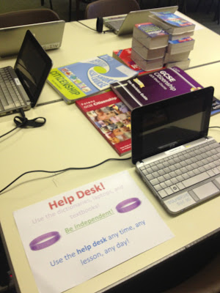
Help Desk/Stuck PowerPoint/Post Its

Slide 13
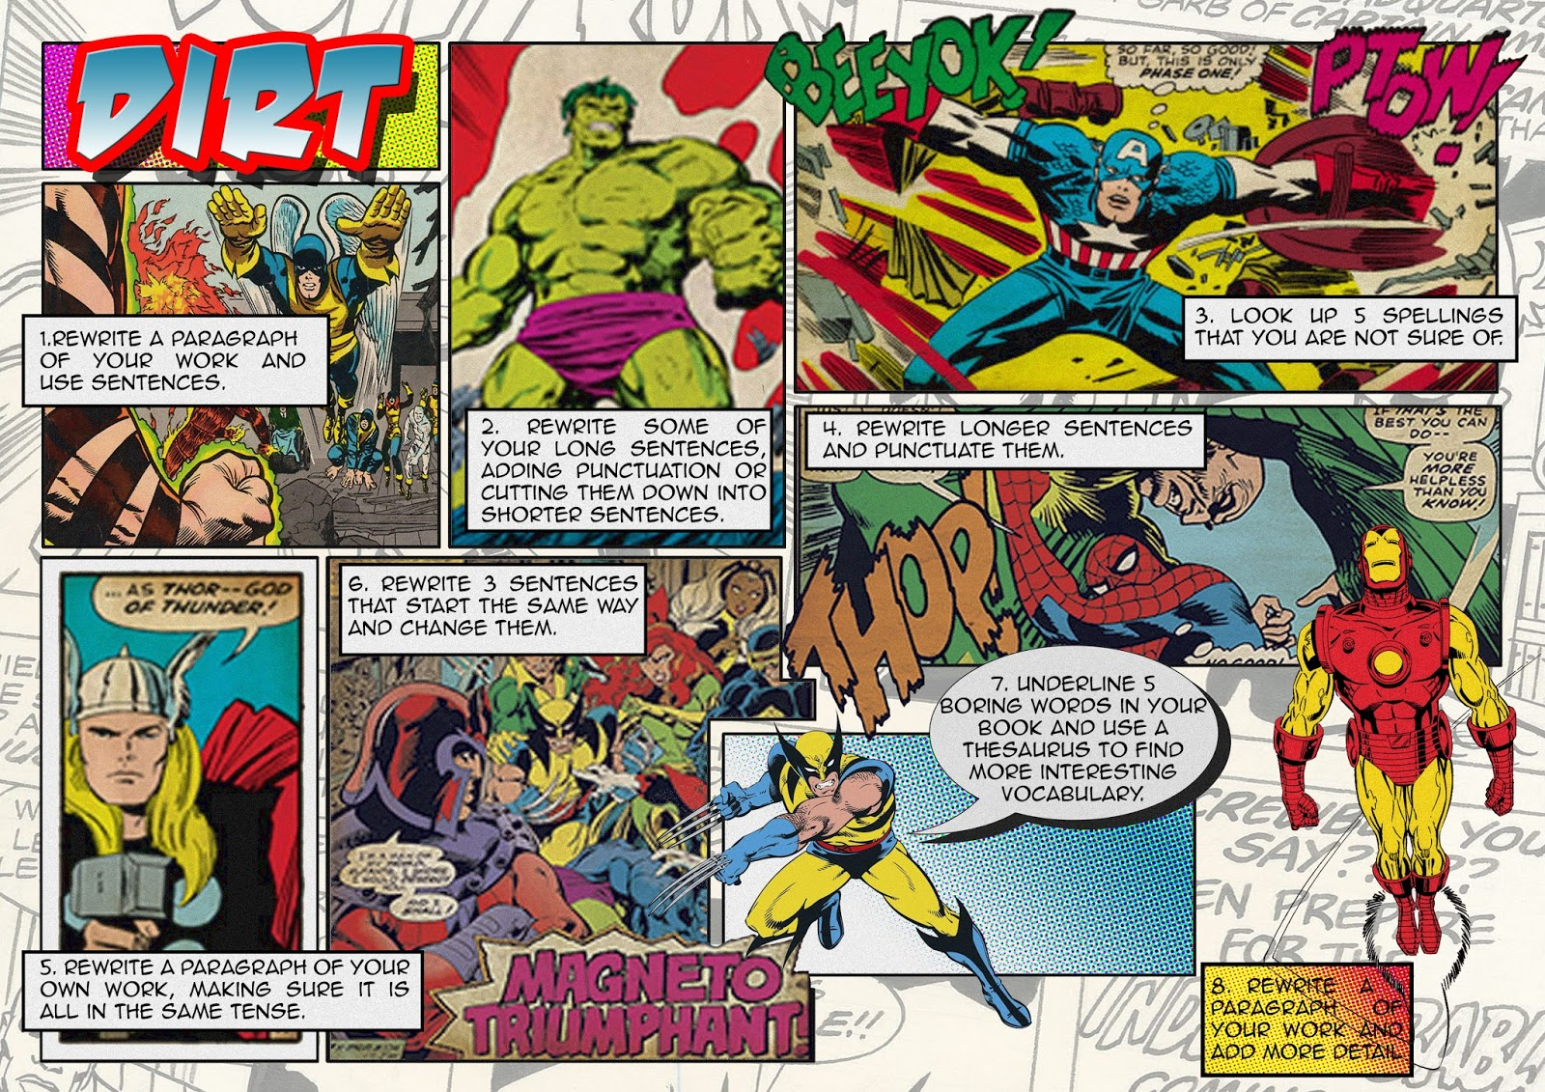
Marking and Feedback
@SeanhamRE

Slide 14
Modelling/Excellence...
@LiteracyLender

Slide 15
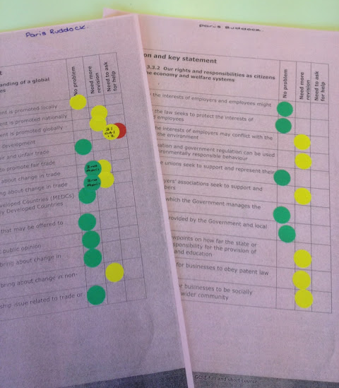
Scaffolding/Tick lists

Slide 16
Dot Marking

Slide 17
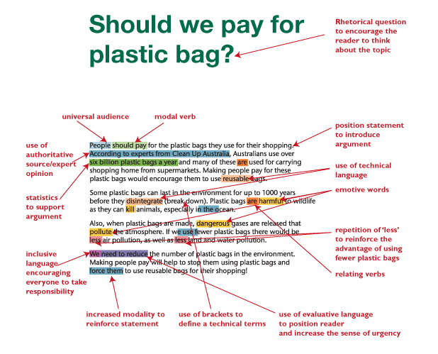
Modelling

Slide 18
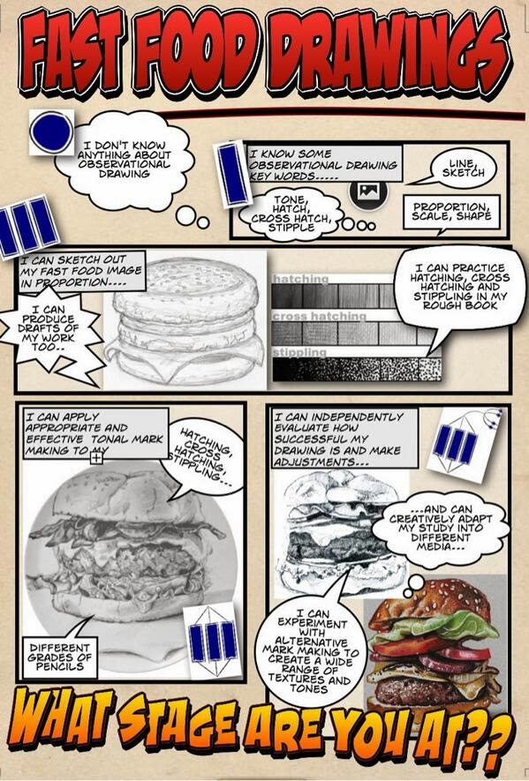
SOLO Taxonomy

Slide 19
Expecting Excellence

Slide 20
Questions & Answers
More resources from Amjad at
www.cheneyagilitytoolkit.blogspot.com
Follow him
@ASTSupportAAli
More from Optimus at
www.optimus-education.com/TL
Follow us
@TeachingOE

Slide 21
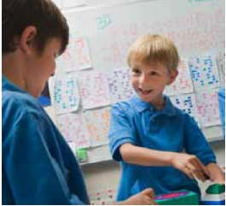
30th September 2015, Manchester • 6th October 2015, London
Gifted and Talented 2015
Stretch and Challenge the More Able
Gain practical classroom strategies, raise pupil aspirations and ensure continuous progress for your most able pupils
Stretch and challenge your more able pupils in every lesson
Successfully raise pupil aspirations for 2O15/16
Make the most of extra-curricular opportunities
Book before 17th
July and
SAVE £30!
Find out more at: www.oeconferences.com/gt15

