Slide 1
PSHE lesson
Is social media bad for your health?

Slide 2
Aims
In this session we will:
Explore how social media is used by teenagers in Britain in 2020
Consider the positives and negatives of social media use
Generate your own recommended guidelines for good use of social media
Notes:
If your lesson is about 40-50 minutes long then I would suggest spending 15-20 minutes on section 1, 15-20 minutes on section 2 and about 10 minutes on section 3.
Through the PowerPoint the whole class questions are highlighted in red. Students will need pen and paper to write with for this lesson.
There are hyperlinks to articles and YouTube clips through the PowerPoint. You might like to look at some of them during the lesson if you have time. Alternatively you might want to give students access to the PowerPoint for them to look through these resources in their own time.

Slide 3
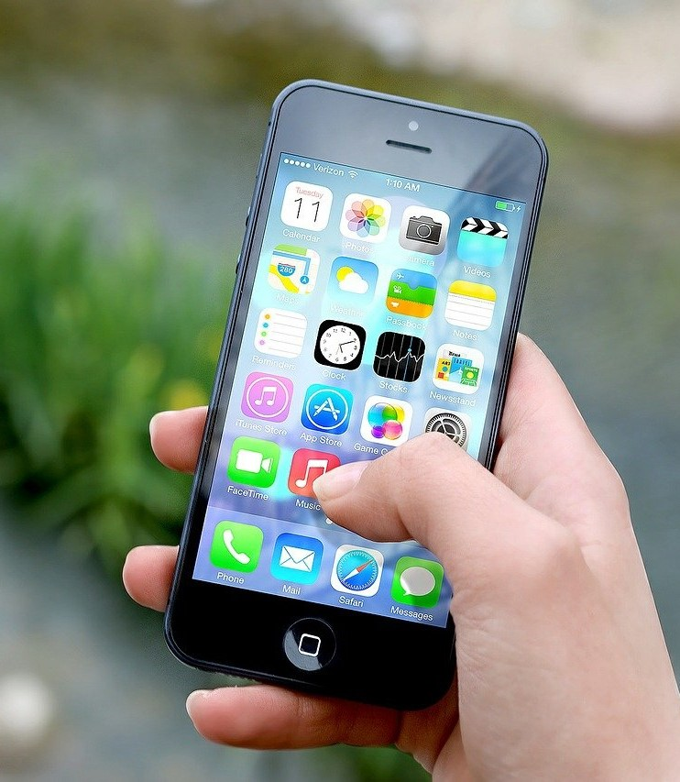
Part 1: teenagers and social media
Questions to get started
What social media do you use and how do you use it?
How MUCH do you use social media each day? (be honest!)
Image by Jan Vašek from Pixabay

Slide 4
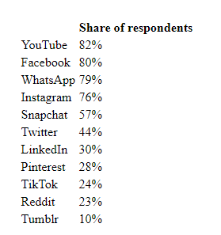
Here is one national picture of social media use. Does this match the picture in your class?
Published by statista.com

Slide 5
This is a graph from a survey of young people in the UK conducted for an article in The Guardian published in February 2019. Does this match the amount of time people in your class spend on social media on average?
Since this survey we have had Covid-19 and lockdowns. How do you think that will have affected the amount of time spent on social media shown by this graph?

Slide 6
Part 2: Positives and negatives of social media use
Part 1: Young People and social media use
As you have just discussed teenagers in Britain use social media a lot!
What do you think are the positives and negatives of social media?
Get into groups of three or four and put together a list of positives and a list of negatives.
Once you have done that and before we have any more discussion take a vote.
How many think that social media is broadly positive for teenagers? How many think it is broadly negative for teenagers?

Slide 7
Some negatives of social media
It is likely that school and your parents have focussed more on the dangers and negatives of social media than its positives! Which of these below were on your list?
Studies have shown that because people generally put idealised pictures and descriptions of themselves and their lives on social media it can lead to people suffering low self-esteem or other mental health issues comparing themselves to these ideals.
In addition social media can also often be used to deliberately make other people feel bad with online bullying. It is widely recognised that people are much more willing to be unpleasant to each other when anonymous behind a computer screen.

Slide 8
Social media can also give you a distorted view of the world. The programmers behind social media want you to click on their pages as often as possible as this means more advertisers pay to advertise with them. Extreme and shocking stories encourage people to look at them meaning that the ‘news’ through social media becomes ever more extreme.
Social media can be very addictive and not only affect sleep but even change the brains of social media users.

Slide 9
Some positives of social media
While social media can cause problems, there are some great benefits as well. Which of these were on your list?
Most obviously social media does allow contact with friends and family wherever they are, and even in lockdown.
Social media can be a brilliant way to develop your creativity.
It has also been found to be very positive for mental health in many cases as shown in this recent Harvard study.

Slide 10
Part 3: Rules you would recommend for good use of social media
It is clear that for social media to be more positive than negative we need to be careful with how we use it.
The charity ‘Young Minds’ has a website with lot of information about social media and the possible impact on mental health.
This video gives advice on how you can use your social media positively.
What rules do you think you should follow to ensure you use social media positively?

Slide 11
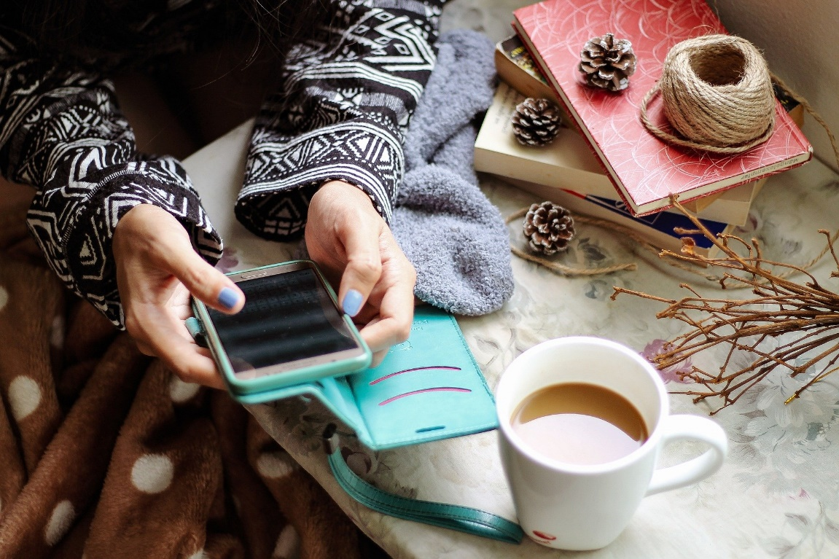
If you have time for a longer read then try this BBC article on the evidence for the impact of social media.
Image by MarieXMartin from Pixabay

