Slide 1
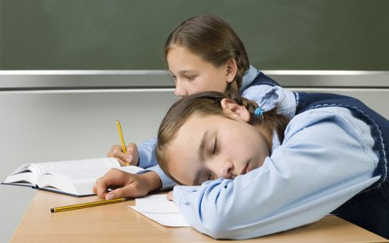
How and why to get a good night’s sleep
Notes:
Perhaps as a starter question ask students how much sleep each night during term time. Encourage them to be as honest as possible!

Slide 2
It has been widely reported in the news that many people have struggled with sleep during the Covid-19 crisis as shown in this article Do you think that your sleep has been affected by the lockdown and ongoing Covid-19 restrictions and worries?

Slide 3
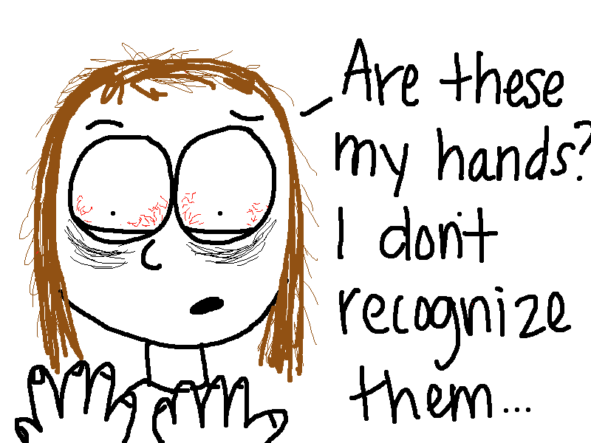
This is adding to a situation in which lack of sleep among teenagers has for years now been seen as one of the biggest health risks for young people in the UK, as you can see in this short clip

Slide 4
This is perhaps not surprising given the number of distractions we all have, from mobile phones to computer games to binge watching on Netflix. Netflix has declared that ‘sleep’ is one of their competitors as they know how many people stay up late binge watching programmes

Slide 5
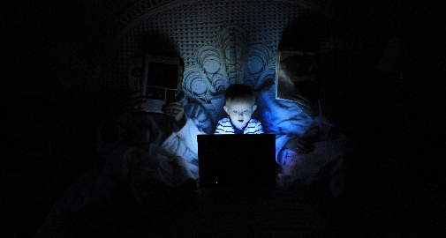
Not only are phones and computers and televisions distracting, but the light from the screens itself lessens the quality of your sleep as explained in this video

Slide 6
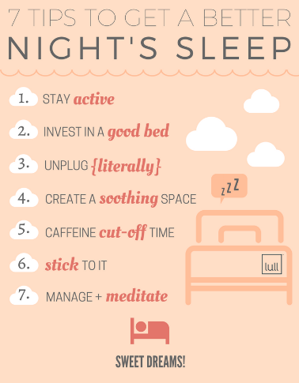
Here then is some advice on how you can improve your sleep patterns:
https://www.sleepfoundation.org/sleep-guidelines-covid-19-isolation
https://www.youtube.com/watch?v=mghlks-kHGc

Slide 7
The scientific explanation of why sleep is so important is well explained in a recent book.
For a summary of some his key ideas try these clips:
https://www.youtube.com/watch?v=oDRrRuPqALs
https://www.youtube.com/watch?v=KpyoDML2eUI

Slide 8
What TWO things do you think you could do to improve your own sleep?

